Slide 1
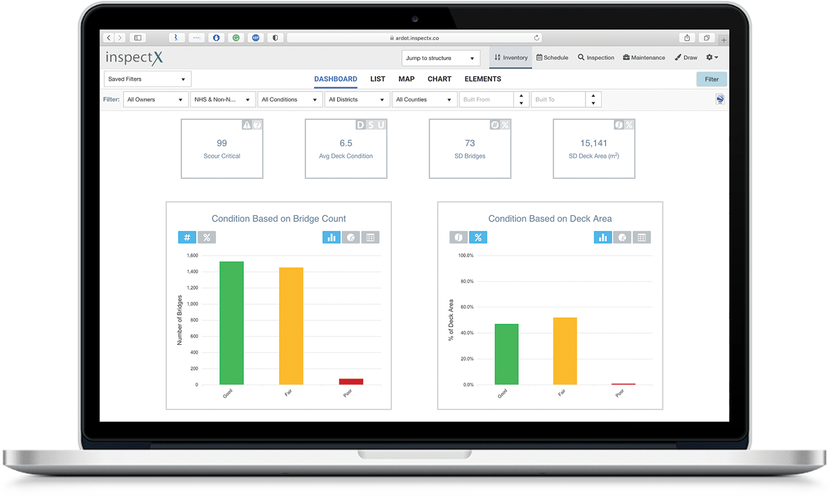
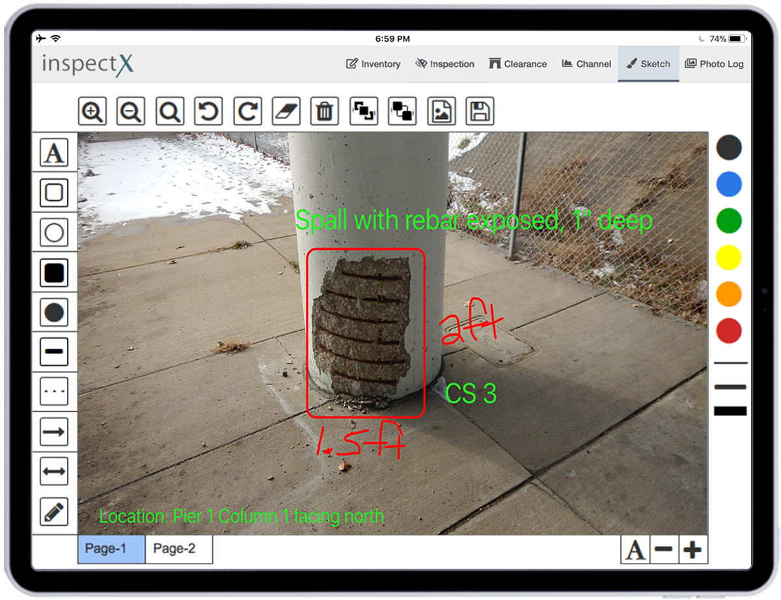
SNBI Data
Collection
ARDOT’s Perspective

Slide 2
Clients
Notes:
I want to take a quick second to acknowledge our clients.
We are very proud to have 9 State DOTs along with the City of LA and a Canadian toll agency as our clients.
Louisiana just joined us this month from AssetWise. We are very honored to have them to be part of the family.
We are going to start the implementation in April and the goal is to go live by July.

Slide 3
InspectX – New Version
Fruitful efforts of our hard work for the past 24 months
Completely rebuilt the whole system from scratch
Compatible with the new NBIS and SNBI changes
Transitioned all existing clients to the new version
Notes:
We have been working very hard the past 24 months implementing the new inspectX. We rebuilt the whole system from scratch. We added a lot of new functionalities and we made sure the system will be compatible with the new NBIS and SNBI changes. As of this month, we have successfully transitioned all of our existing clients to the new version.

Slide 4
Statistics
6 States
Live
3 States
Implementation
83,540
Tablet Inspection
6,790
Ancillary Str
122,600
Bridges
45
Tunnels
Notes:
Almost all inspectors use the tablet for offline data collection

Slide 5
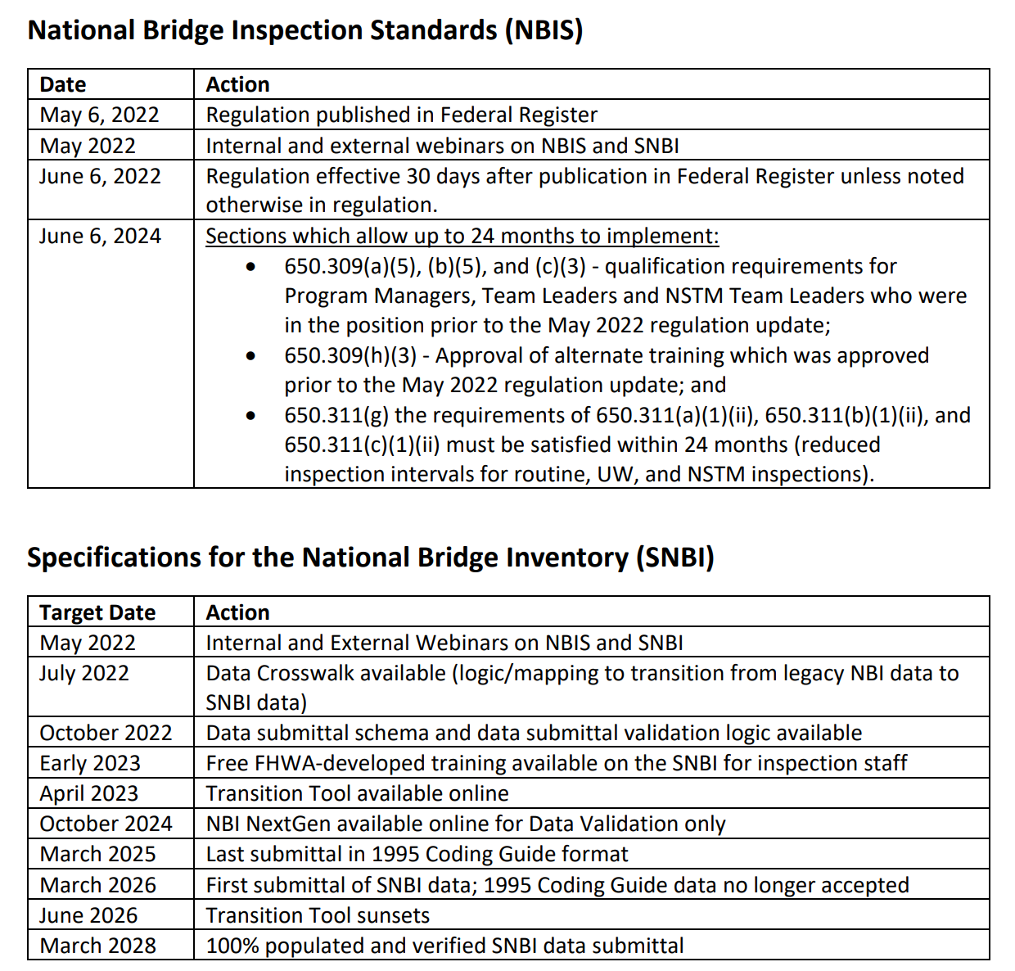
Looking Ahead
Been 10 months since regulation is published!
Early 2023, Free FHWA SNBI Training will be available
April 2023, Transition tool will be available by FHWA
June 2024, Implement qualification/interval requirements
35 months until the first SNBI submittal
Notes:
Just a little background. The new NBIS has been YEARS in the making. It went through many iterations OVER THE YEARS. The proposed rule finally came out in November of 2019. After a 30-month long hiatus, the final rule was published. The reg became effective in June. This is a huge milestone for FHWA.
??Which image is related to which bullet point??

Slide 6
SNBI Status for Software Vendors
AASHTO BrM - delayed to mid 2023 per BrMUG
AssetWise - to be announced
inspectX - SNBI ready, clients started testing and data collection
May pose additional challenges to agencies if software vendors are not ready in time.
Some states started data collection using Excel or Access.

Slide 7
Poll Question
What is your agency’s timeline for SNBI data collection?
Collecting data right now
Will start data collection in the next few months
Will start data collection later in 2023
Will start data collection in 2024
Notes:
500k to gain access in 2023
Otherwise in 2024

Slide 8
Poll Question
What are your primary challenges with SNBI Data Collection?
Staff is not ready
Need to develop an inspection manual first
Getting consultant contracts in place
Getting proper guidance from FHWA
Software is not ready
Notes:
500k to gain access in 2023
Otherwise in 2024

Slide 9
Round Table Discussion
When do you plan to start data collection?
Do you plan on doing it in-house, hire consultants or both?
Have you started collecting the new condition ratings? (ie NSTM/UW)
What is stopping you from collecting SNBI data sooner
Do you have 48-months inspection cycles?
What are some challenges?
Notes:
High level estimate during the commenting period

Slide 10
SNBI Data Collection

Slide 11
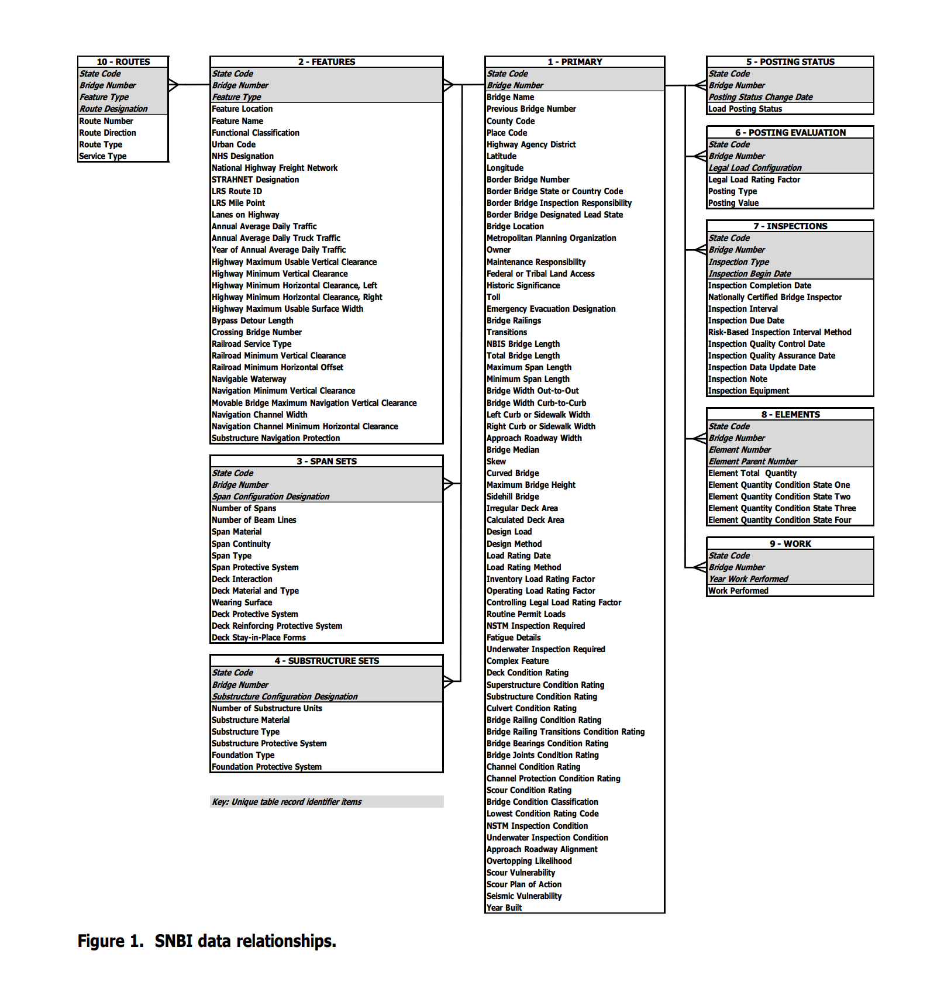
SNBI Data Overview
No more flat structure
One-to-one tables
Many-to-one relationship tables
New items 54, discontinued 20, continued 100
Significant increase in data collection efforts

Slide 12
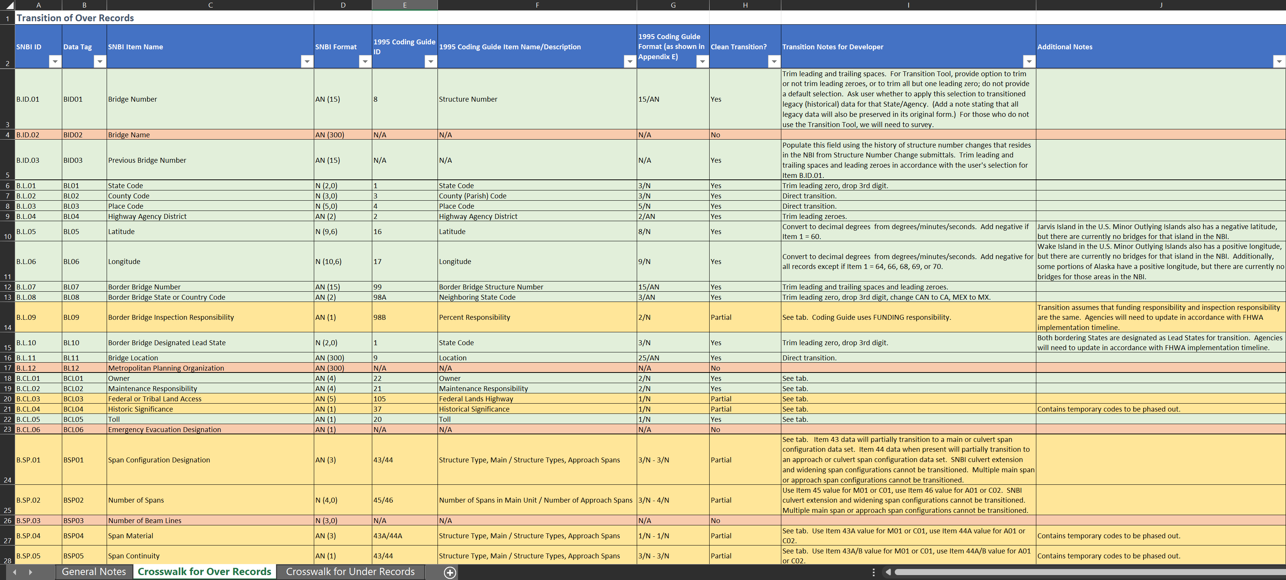
SNBI Data Crosswalk
FHWA provided detailed mapping between the old and the new coding guide
Applicable to over and under records data fields
There are 3 types of transition: (clean, partial, and no transition)
Partial transition contains temp codes
Complicated stuff…

Slide 13
Crosswalk Examples
Clean Transition
Item 10 Inventory Rte Min Vert Clr. B.H.12 Hwy Max Useable Vert. Clr.
Partial Transition
Item 49 Structure Length B.G.01 NBIS Bridge Length
No Transition
B.G.13 Maximum Bridge Height
Convert to English units. Use 99.9 for values of 30m or greater.
Convert when Item 49 is greater than 9.1 meters. Otherwise, no value.
New SNBI field

Slide 14
SNBI Transition Tool
FHWA will provide transition tool by April 2023
It is still on schedule to be released per FHWA
No details in how the data will be transitioned

Slide 15
Data Collection Strategy
Many ways to slice the pie
Spoke to various states during conferences
Some plan to use excel and collect the data independently
Some plan to use multi-disciplinary teams
Some plan to use only inspectors
Some plan to use consultants
Some plan to divide the data sets into different inspection cycles
inspectX has the flexibility and configurability to handle different approaches

Slide 16
How inspectX Can Help
Support multi-disciplinary team approach
HQ Team
Consultants
Inspection Team
Local Agencies
Design Team
Other

Slide 17
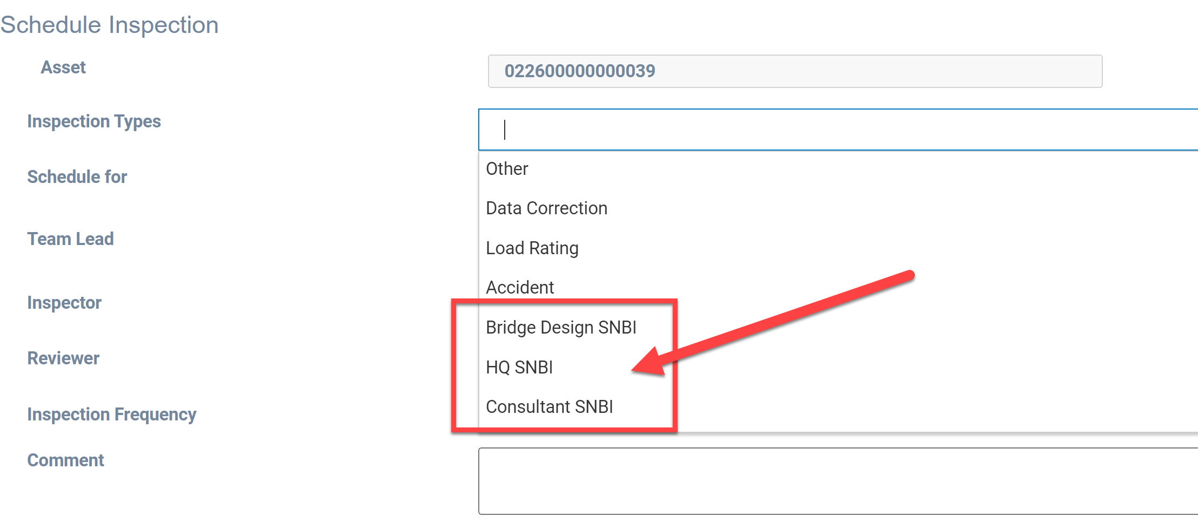
How inspectX Can Help
Configurable inspection types

Slide 18
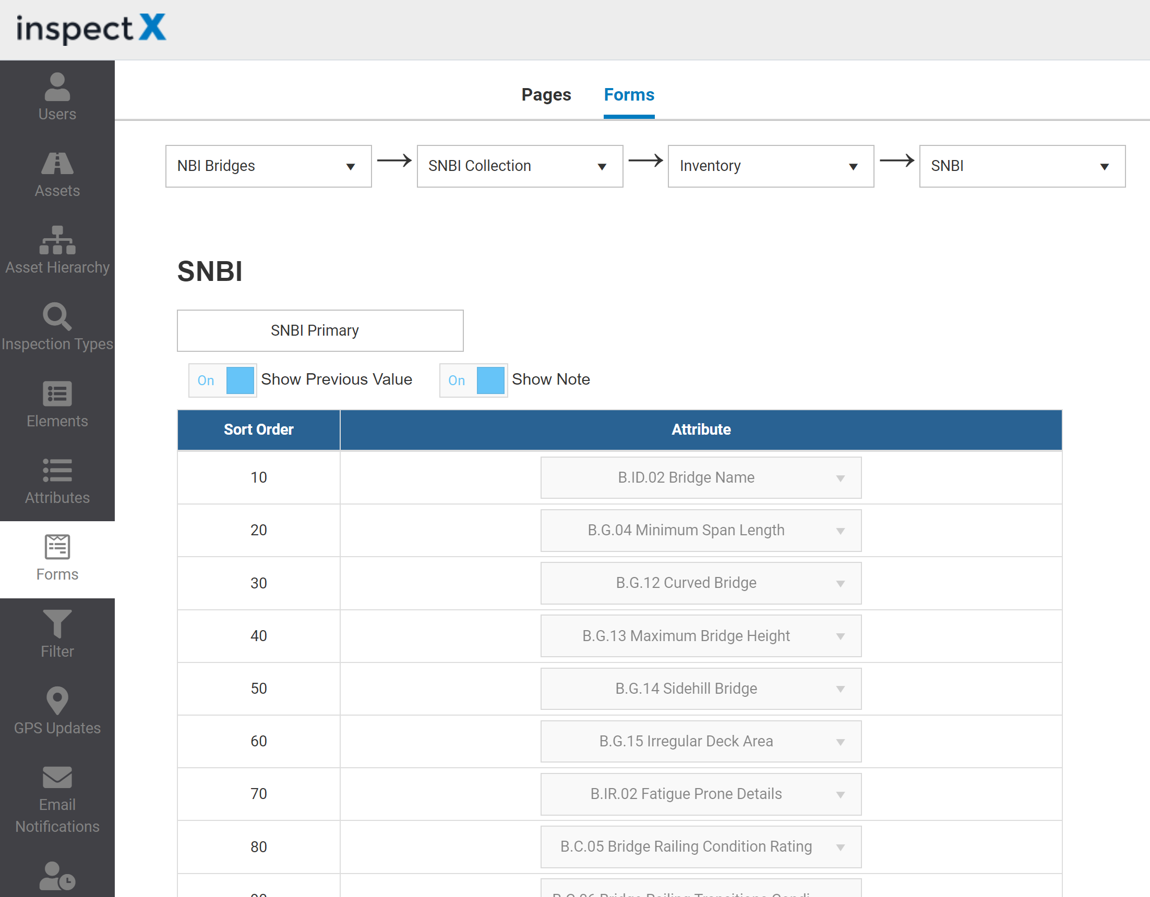
How inspectX Can Help
Configurable inspection types
Configurable inspection forms
Divide fields to subpages
Different layout per insp. type
All in Admin Settings
Notes:
Change the photo to a less wide one

Slide 19
How inspectX Can Help
Configurable inspection types
Configurable inspection forms
Each team can have access to a specific set of SNBI fields
ie. Design Team can collect the inventory data using plans
ie. Inspection Team can collect condition and clearance data from the field
Divide and conquer

Slide 20
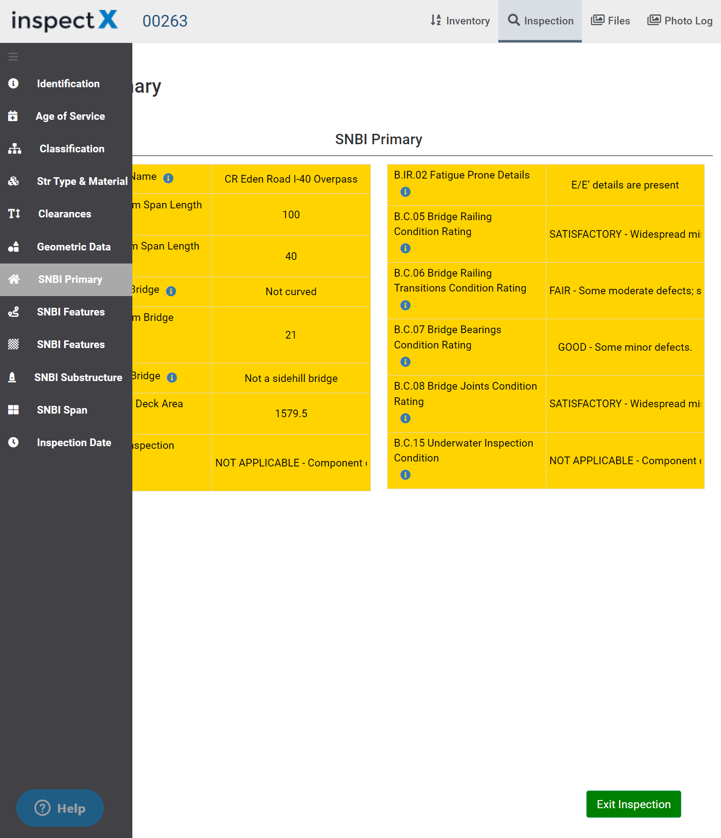
How inspectX Can Help
Support both NBI and SNBI within the same inspection type
Much easier transition
Retain NBI data history
Tablet-based data collection to maximize efficiency
NBI Data Set
SNBI Data Set
Notes:
Change the picture to a less wide photo

Slide 21
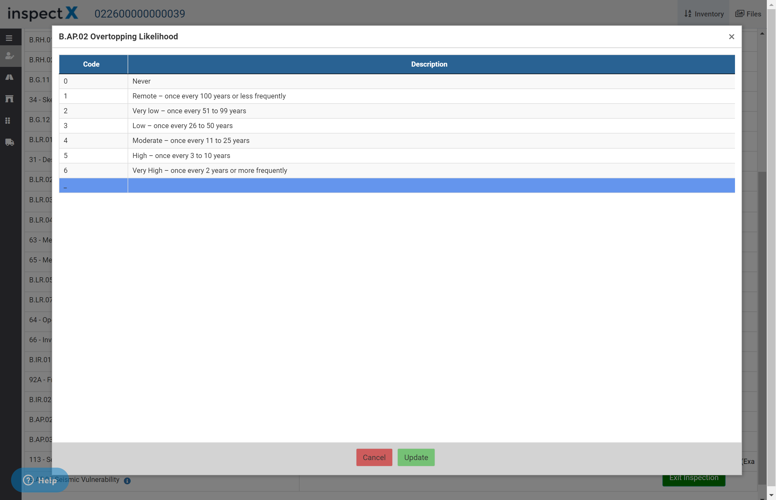
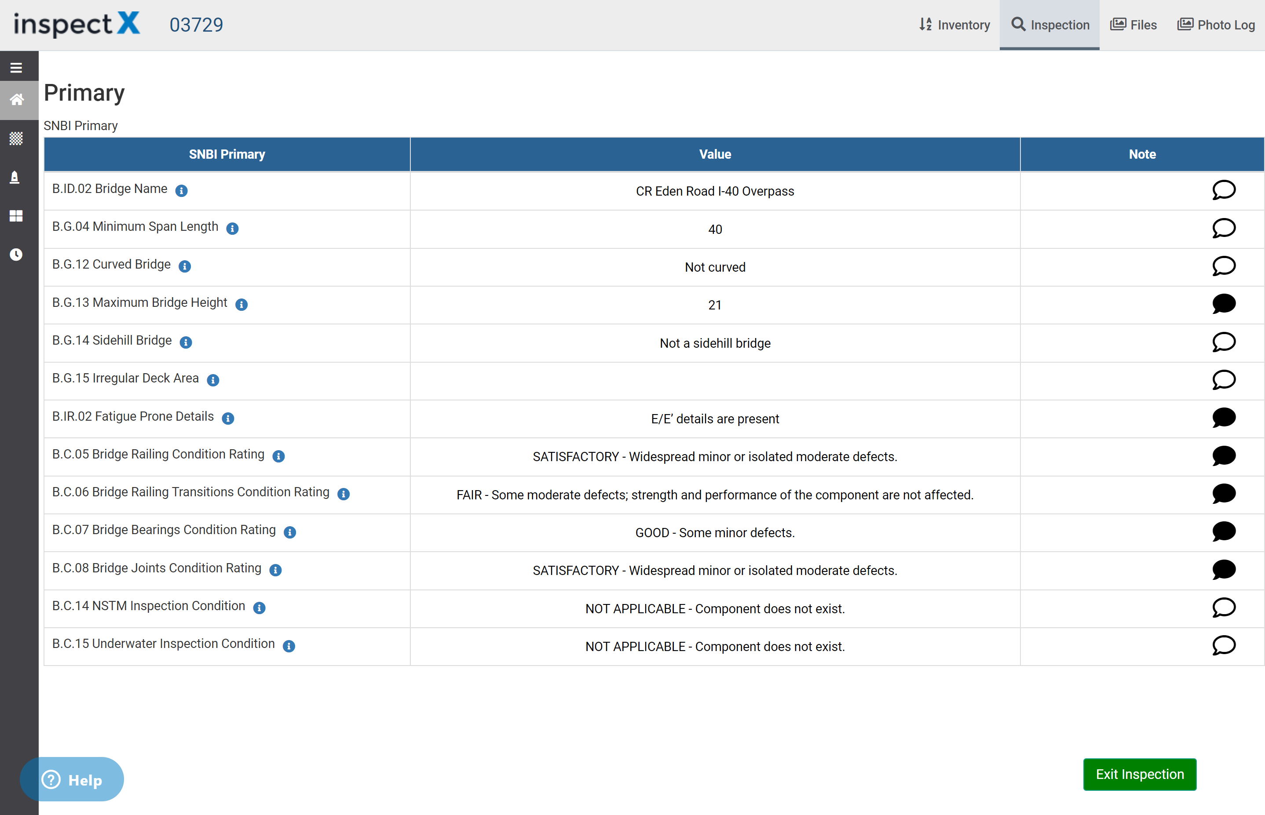
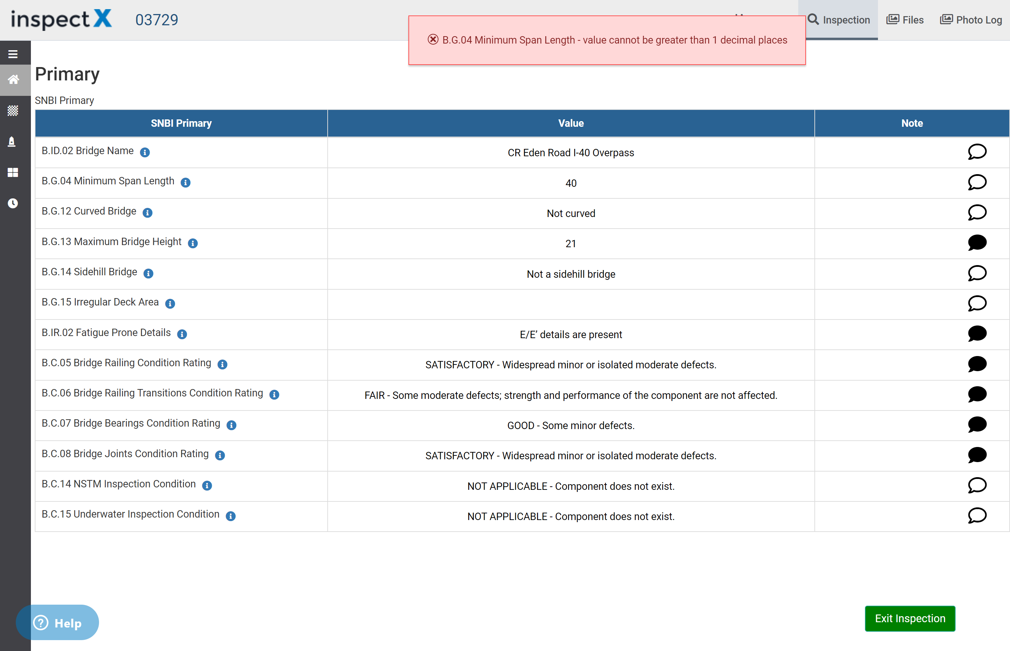
How inspectX Can Help
Has built-in validations to minimize errors
Attribute lookups and descriptions are included

Slide 22
How inspectX Can Help
Help clients with data transition from NBI to SNBI
Clean
Partial
No transition
Export NBI Data
FHWA Transition Tool
inspectX

Slide 23
Arkansas DOT’s Experience
First inspectX client to collect the SNBI data
Started in late January
Currently only using in-house HQ staff
Data collection was mainly done from the office
Only collecting SNBI fields with no transition
Plan to use the transition tool for the remaining data and mass update
Scheduled | 56
In-Progress | 60
Approved | 68
Total | 184

Slide 24
ARDOT’S EXPERIENCE

Slide 25
Summary

Slide 26
Summary
The new inspectX is ready to adopt the new SNBI
All our clients are moved to the new version.
Support both NBI and SNBI data collection at the same time
Configurable forms and inspection types
Support multi-team approach
Help clients migrate NBI → SNBI per the crosswalk!!
If your agency or company collects data in Excel/Access, we can help you
We want your feedback, many of the great ideas came from you!

Slide 27
Q & A

Slide 28
Thank You
KENNY TONG
CUSTOMER SUCCESS MANAGER
ktong@bridge-intel.com

