Slide 1
Ease Your Transition
To The New NBIS
June 2022
BRIDGE INTELLIGENCE, 2021
Notes:
Welcome everyone. Thank you all for join today.
I went through the registration beforehand saw there are over 20 states attending today. This just shows how much you all care about this topic. I want you all to know that we are here to help. Our goal is to make your transition as seamless as possible.

Slide 2
The wait is over!
Years in the making! Went through many iterations
11/12/19, The proposed NBIS rule was published
5/6/22, The final rule was published in the Federal Register
6/6/22, The regulation became effective
Huge milestone for FHWA
Notes:
Just a little background. The new NBIS has been YEARS in the making. It went through many iterations OVER THE YEARS. The proposed rule finally came out in November of 2019. After a 30-month long hiatus, the final rule was published. The reg became effective in June. This is a huge milestone for FHWA.

Slide 3
Big Changes Are Coming
Maintain a registry of certified bridge inspectors
Schedule tolerance changes
Inspection interval updates
Reporting and monitoring of critical findings
NBI -> SNBI Format
Collect crash tested data
Collect span and substructure data
Report work performed data
Etc…

Slide 4
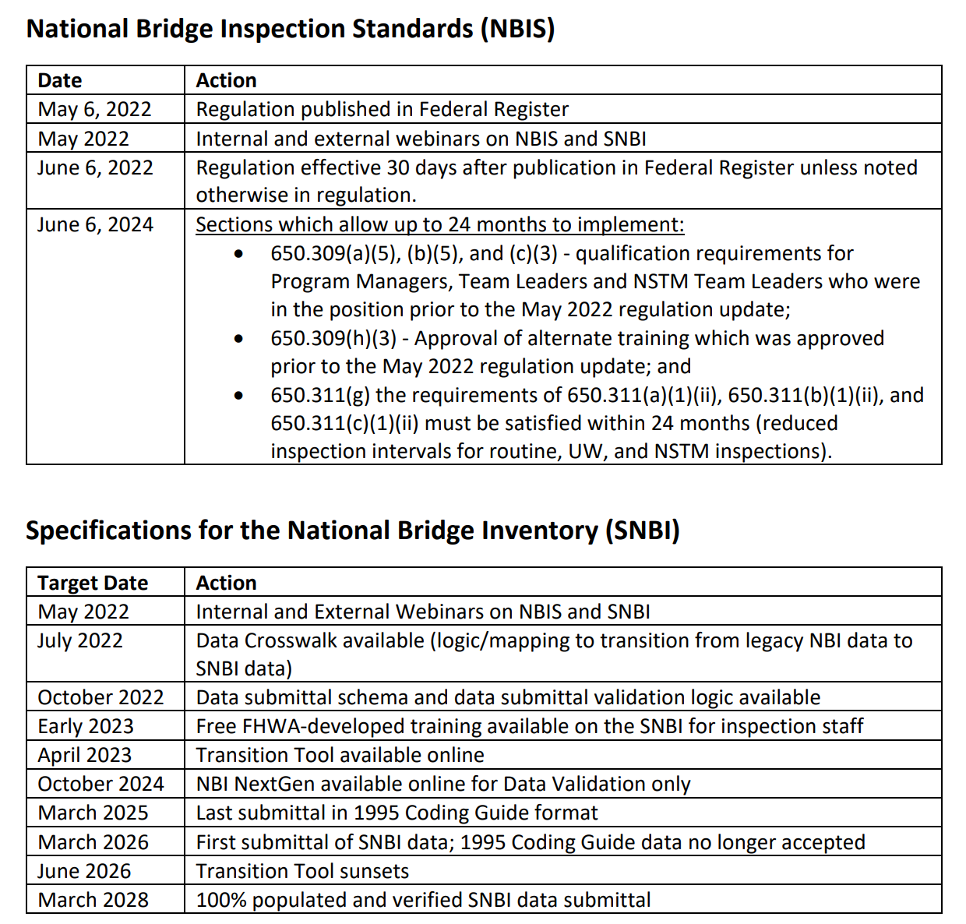
Burden on the Owners
Implementation cost comments from NPRM
1 hr. to 10 hrs. per bridge
$40 to $100 per hr.
$234 per bridge
$200k to $18m
Implementation timeframe
≈ 24 months for part of new NBIS
≈ 45 months to 1st SNBI submittal
https://www.fhwa.dot.gov/bridge/pubs/NBIS-Implementation-Timeline-5.3.22_508.pdf
Notes:
High level estimate during the commenting period

Slide 5
Chat Question
Which NBIS or SNBI change(s) will be the most challenging for you?

Slide 6
Relieving that Burden
Leverage technology
Trust systems not humans
Streamline logic and processes
It should be so simple and straightforward that you cannot get it wrong!
Reduce manual work
Ultimately save time and cost

Slide 7
InspectX – New Version
Fruitful efforts of our hard work for the past 20 months
Completely rebuilt the whole system from scratch
Compatible with the new NBIS and SNBI changes
In the process of transitioning our clients to the new version
Notes:
We have been working hard for the past 20 months to upgrade inspectX to meet the new NBIS
We are transitioning our clients to the new version and all our clients will be on the new version in the next few months.

Slide 8
Adopting the New NBIS Changes

Slide 9
Reference
Already supported in inspectX
Implementation in-progress

Slide 10
Inspection Schedule Tolerance
Much more lenient
No longer using +1, 2~4 and 4+ months for compliance
Allow tolerance of 3 months beyond the inspection due date (lower risk)
Allow tolerance of 2 months beyond for interval less than 24 months (higher risk)
inspectX Solution:
Updating the Schedule Management Section
Calculate based on the new tolerance
Divide into higher risk and lower risk
Allow users to easily query and monitor upcoming/overdue inspections

Slide 11
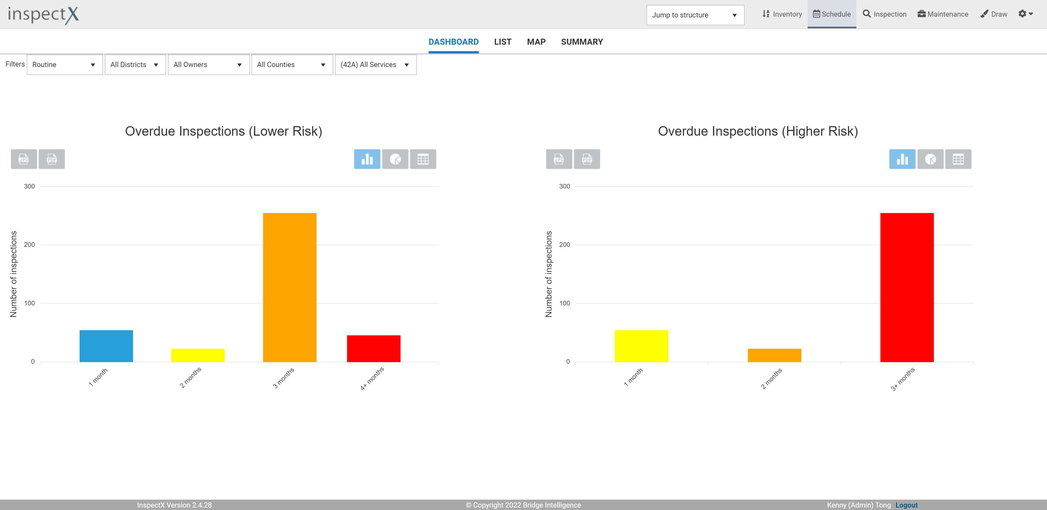
Inspection Schedule Tolerance
Dashboard/List/Map
Lower and Higher risk
Monitor upcoming/overdue
No need to track manually

Slide 12
Registry of Certified Bridge Inspectors
Owners must maintain the following data
Unique identifier for each inspector
Inspector’s qualifications
Additional qualifications for NSTM and UW inspections
Detailed information about any adverse actions about the inspector
18 hours of refresher training over rolling 60-month period
Burden on owners to chase down inspectors for qualifications
Lack of a centralized registry

Slide 13
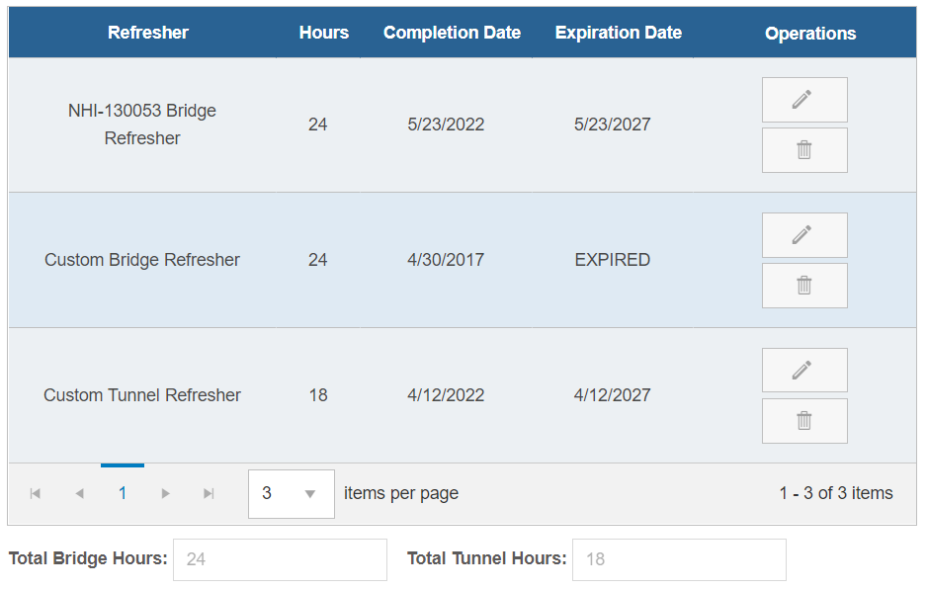
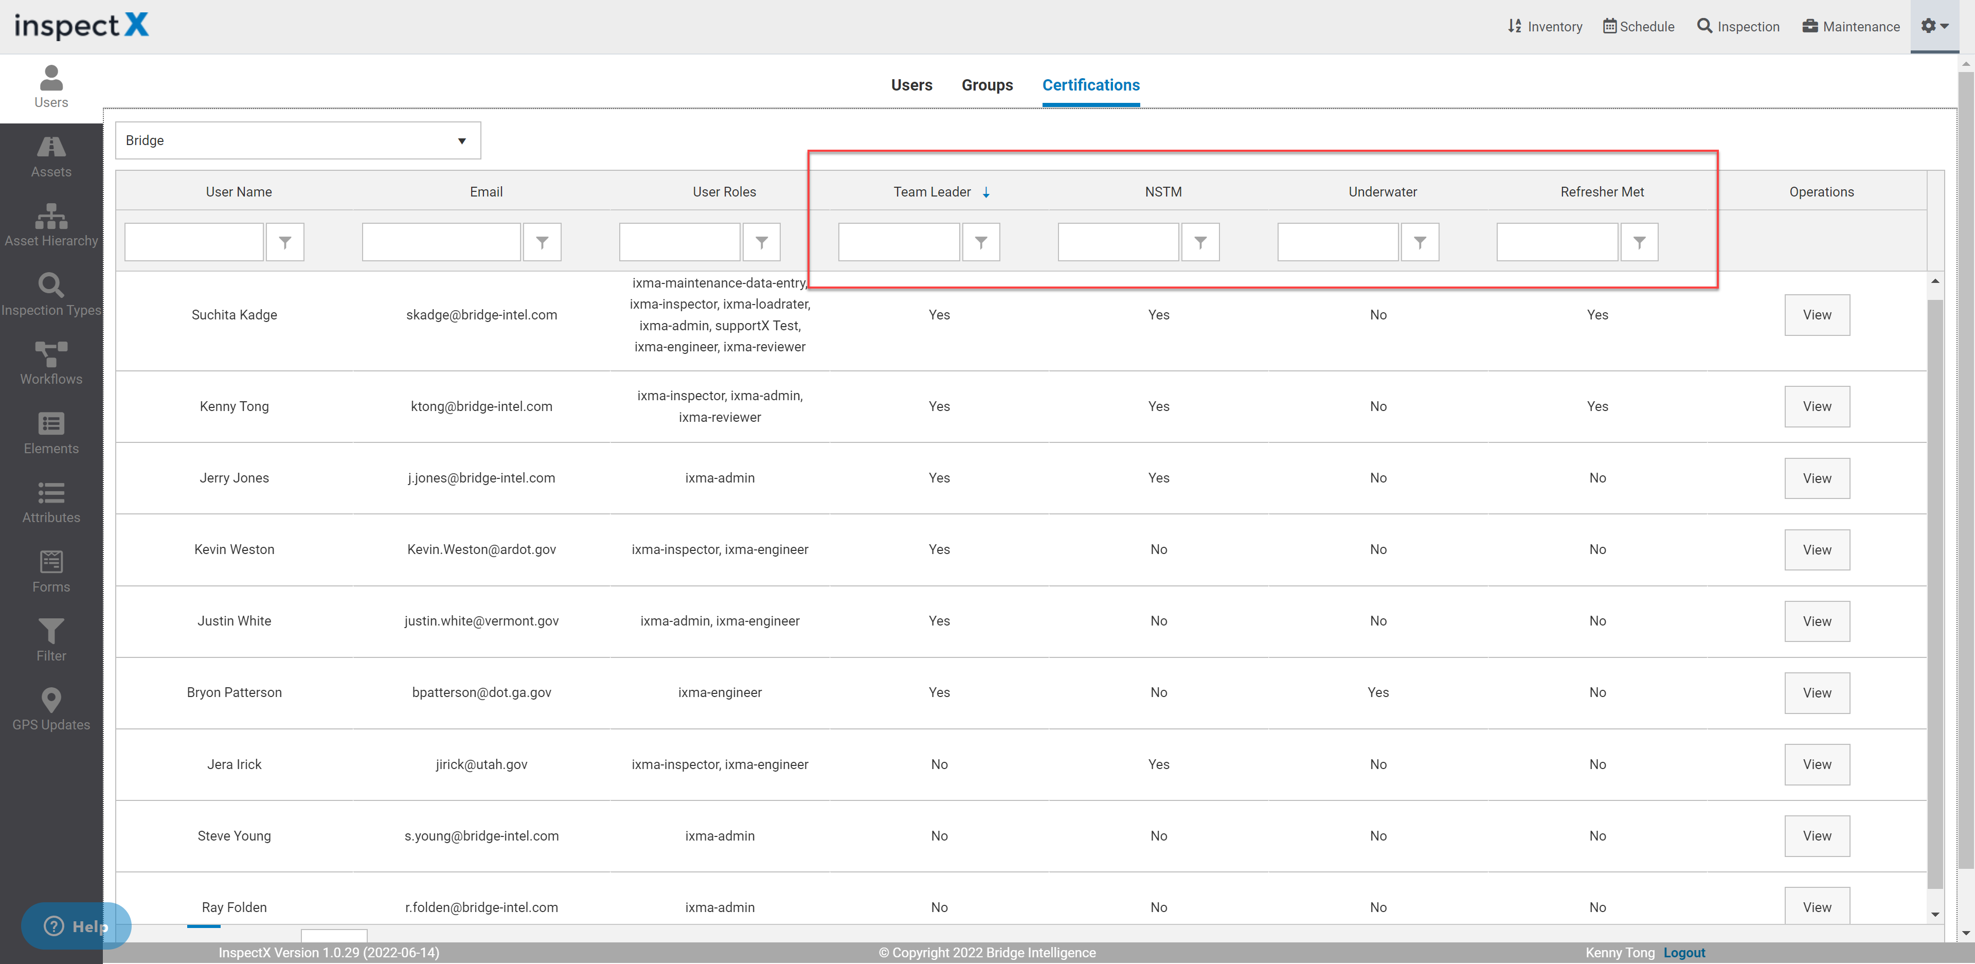
Registry of Certified Bridge Inspectors
inspectX Solution
Assign unique identifier to each user in inspectX
Every user can upload qualifications
Admins can monitor & manage registry
Automatically track refresher hours
Downgrade access if missing qualifications

Slide 14
Increasing Inspection Interval Criteria
Method 1- Criteria is mainly driven by condition (i.e. Rating ≥ 6)
Routine (up to 48 months)
NSTM (up to 48 months)
Underwater (up to 72 months)
Method 2 – Rigorous assessment. Defined by agencies
inspectX Solution
Help our clients generate queries to identify bridges
Help our clients mass update inspection interval
Notify team if interval is invalid (i.e. Deck = 5, interval should not be 48 mo.)

Slide 15
Reduced Inspection Interval Criteria
Inspection interval must be reduced if condition rating ≤ 3
Routine cannot exceed 12 months
Underwater cannot exceed 24 months
NSTM cannot exceed 12 months
Deadline set by FHWA is June 6, 2024
Have 24 months to collect the new condition ratings
B.C.11 Scour Condition
B.C.14 NSTM Inspection Condition
B.C.15 Underwater Inspection Condition

Slide 16
Reduced Inspection Interval Criteria
Routine interval cannot exceed 12 mo. if any of the following applies:
Deck Condition ≤ 3; OR
Superstructure Condition ≤ 3; OR
Substructure Condition ≤ 3; OR
Culvert Condition ≤ 3; OR
Scour Condition ≤ 3
Underwater interval cannot exceed 24 mo. if any of the following applies:
Underwater Inspection Condition ≤ 3; OR
Channel Condition ≤ 3; OR
Scour Condition ≤ 3
NSTM interval cannot exceed 12 mo. if any of the following applies:
NSTM Inspection Condition ≤ 3

Slide 17
Reduced Inspection Interval Criteria
inspectX Solution
Help our clients generate queries to identify bridges
Help our clients to mass update inspection interval
Notify team if interval is invalid
i.e. Deck = 2, interval should not be 24 months

Slide 18
Critical Finding
Immediate critical Finding if
Deck/Super/Sub/Culvert/Channel ≤ 2
State custom policy
Notify FHWA within 24 hours
Submit report to FHWA until they are resolved

Slide 19
Critical Finding
Report – Minimum Requirements
Owner
NBI Structure Number
Date of finding
Description and photos of the critical finding
Description of the planned corrective actions
Status of corrective actions: Active / Completed
Estimated date of completion
Date of completion

Slide 20
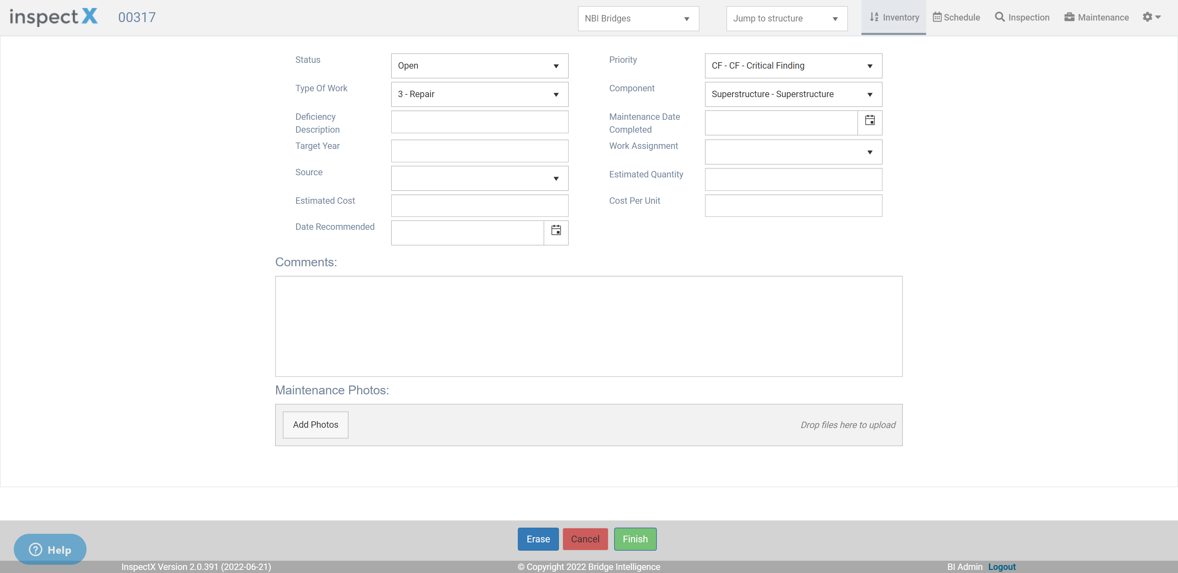
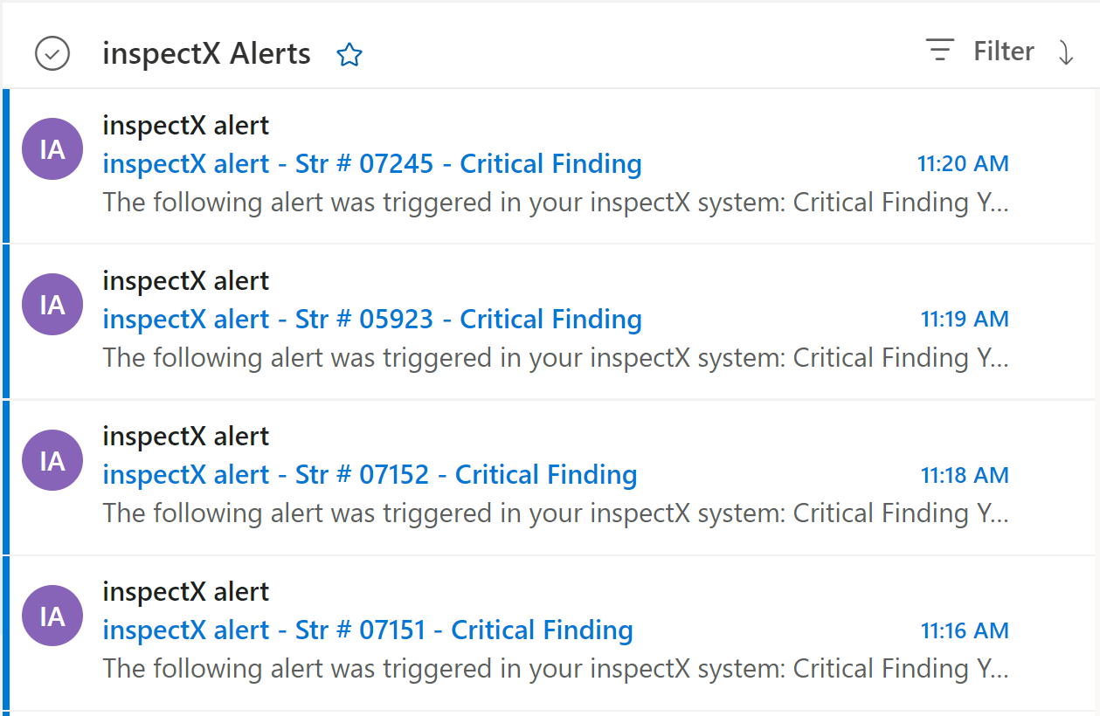
Critical Finding
inspectX Solution
Configure maintenance section to include extra required fields
Automated alerts to notify managers and FHWA
Automatically send monthly aggregate reports to FHWA
Need to work with clients to setup report and email template

Slide 21
Border Bridge Data
The lead state will submit a full bridge record
The neighbor state(s) will submit an ABBREVIATED bridge record
Abbreviated format is TBD
inspectX Solution
Import border bridge data directly to inspectX
This is supported for existing NBI format
Waiting for the abbreviated format for SNBI
No manual data entry for our clients

Slide 22
SNBI Transition

Slide 23
Poll Question
Ideally when would you like to start collecting SNBI data?
As soon as possible
Before the end of the year
Starting in 2023
Starting in 2024

Slide 24
Poll Question
What is your biggest concern regarding transition to the SNBI?
My software platform is not ready
Training the inspectors
Increase in contract cost for consultants
Huge increase in time in the field
Lack of personnel and resources

Slide 25
Perspective from State DOTs on SNBI Transition
We will invite you on Stage to briefly speak
Make sure your microphone is unmuted
Thank you for your participation :)

Slide 26
SNBI Data Collection
First submittal of SNBI is due March 2026
May seem a lot of time…..but
Agencies have about TWO inspection cycles to collect the data
Steep learning curve for inspectors
Inspectors should have access to both NBI and SNBI data sets while inspecting during the transition

Slide 27
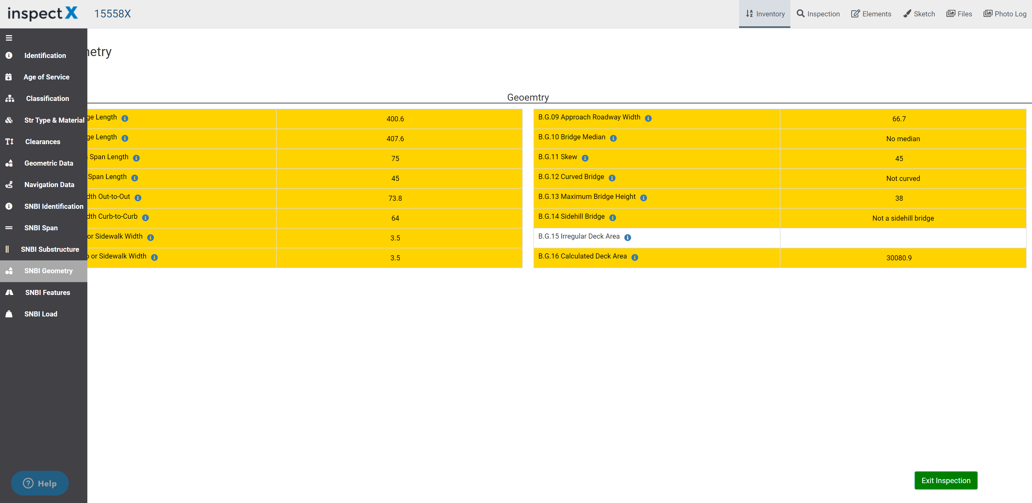
SNBI Data Collection
inspectX Solution
Support both NBI and SNBI within the same inspection
Much easier transition
Minimize back and forth
Tablet-based data collection
No manual data entry back in office
Convert to SNBI once crosswalk is out in July
Automated process
Recommend not to wait, start ASAP!
NBI Data Set
SNBI Data Set

Slide 28
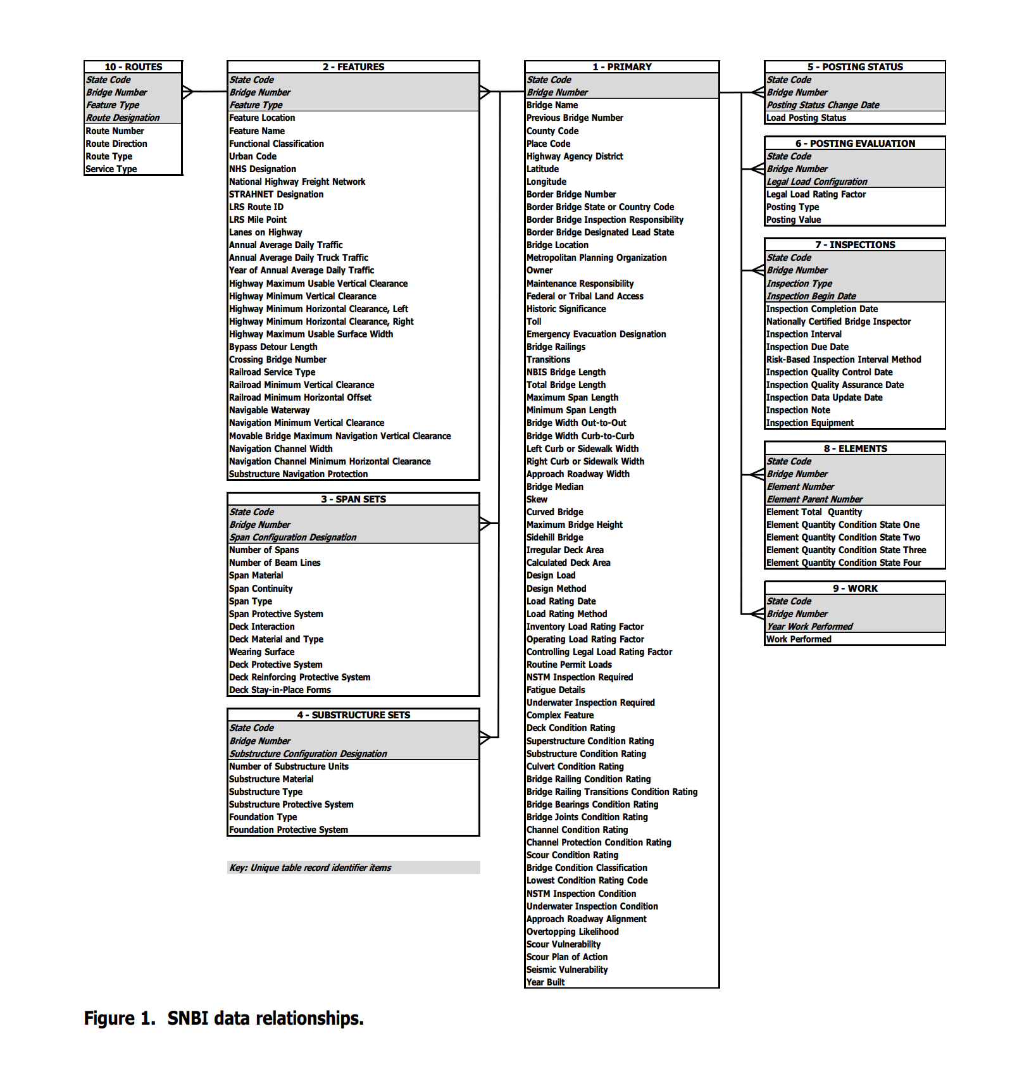
SNBI Data Overview
No more flat structure
One-to-one tables
Many-to-one relationship tables
New items 54, discontinued 20, continued 100

Slide 29
Primary Data Set
inspectX can support any NBI/SNBI/Agency attributes
Many of the lookup values have been changed
Attributes are updated per the Final SNBI
Admins can configure inspection form to meet their needs

Slide 30
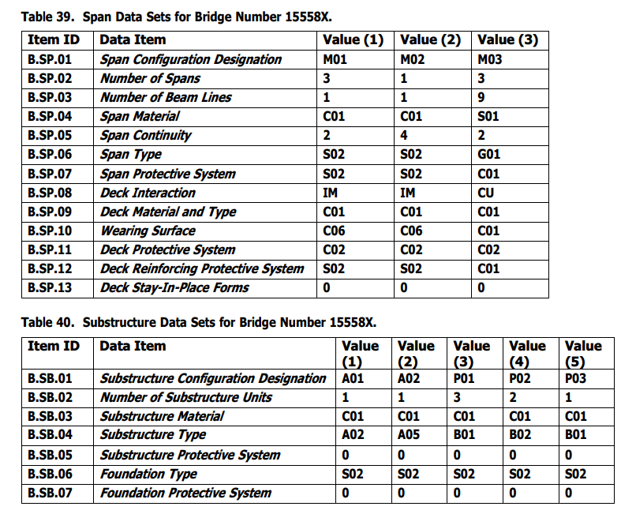
Span and Substructure Data Sets
Many-to-One Relationship
Child of the Primary Data Set
New requirement
Big increase in data collection

Slide 31
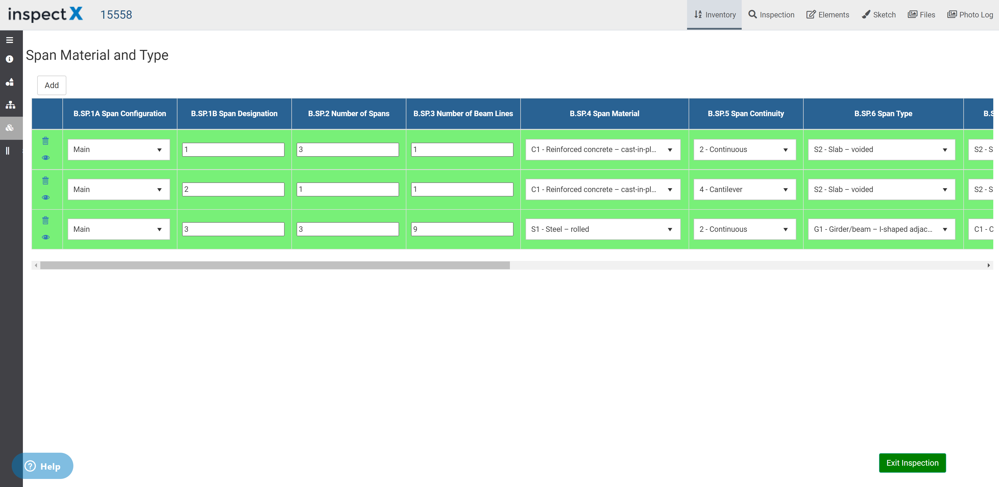
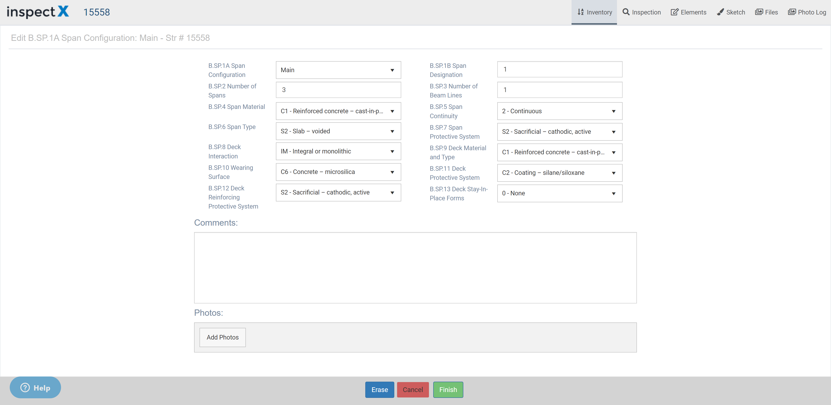
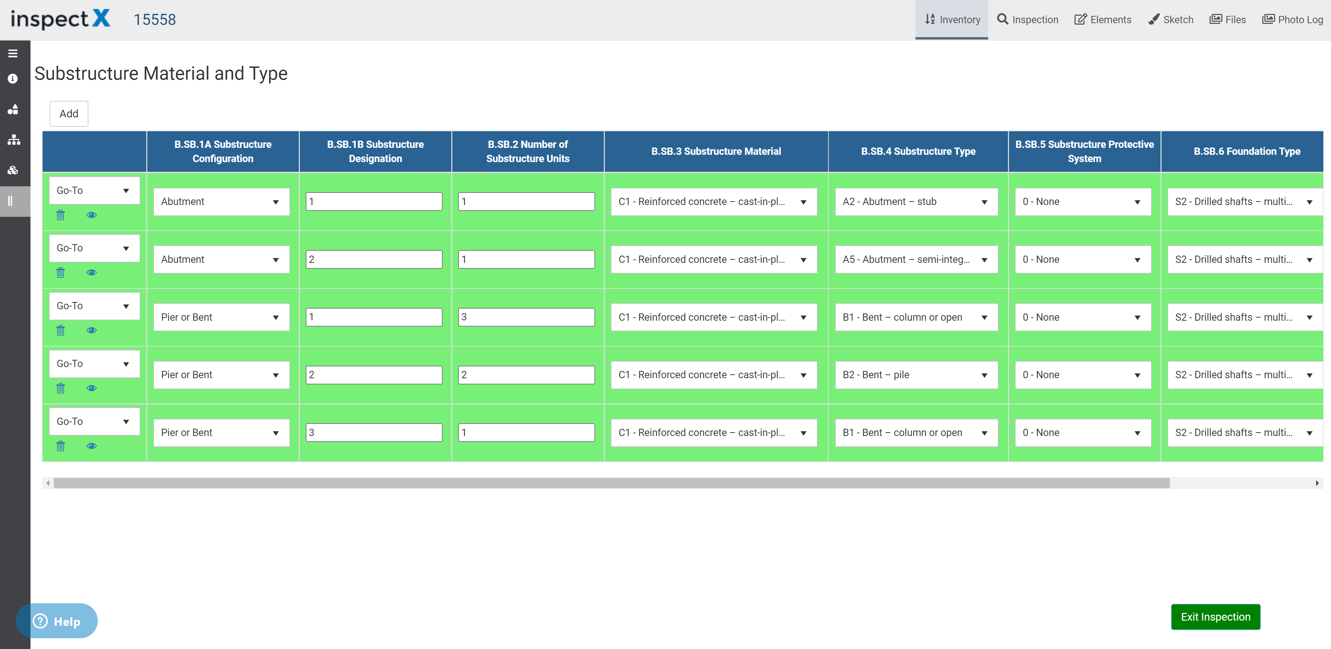
Span and Substructure Data Sets
inspectX Solution
Supported out-of-the-box
Multiple ways to input data
Horizontal scroll bar
Detailed form view
Ability to assign photos
Can also add state fields

Slide 32
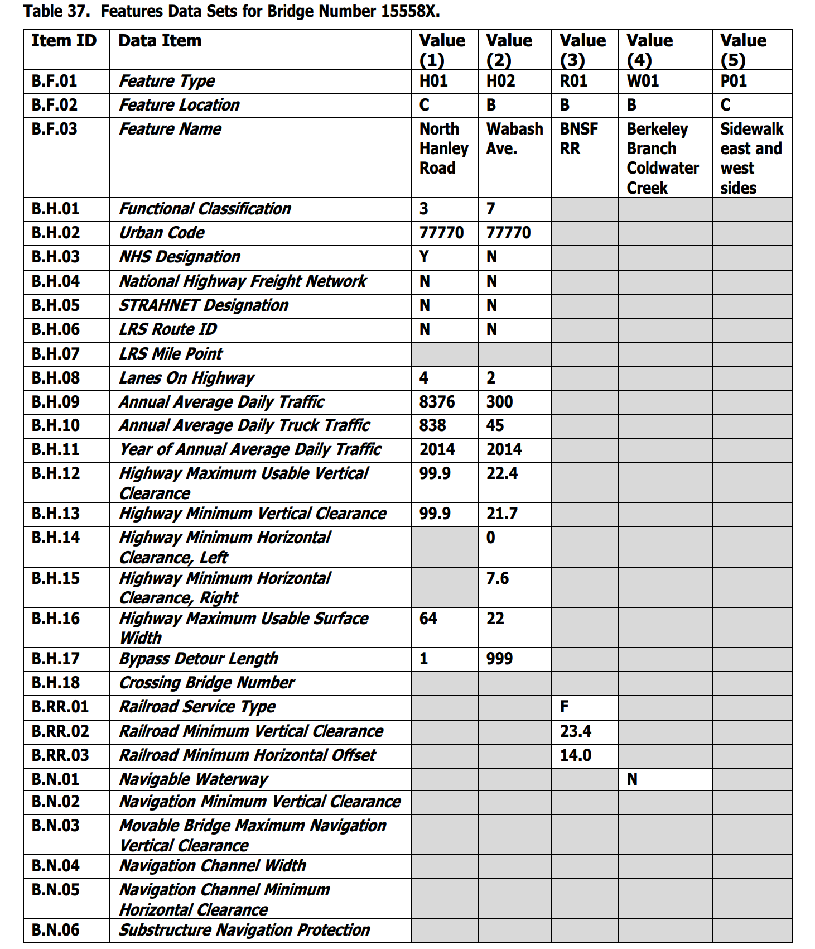
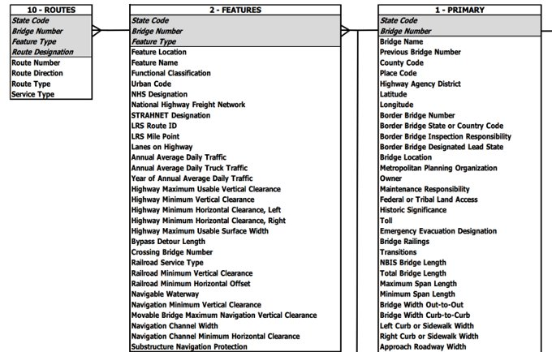
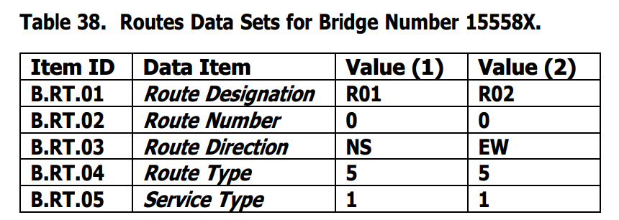
Features and Routes Data Set
Draft SNBI had Routes & Features Combined
Final SNBI separated Routes & Features
Primary → Features → Routes
Many-to-one relationship tables

Slide 33
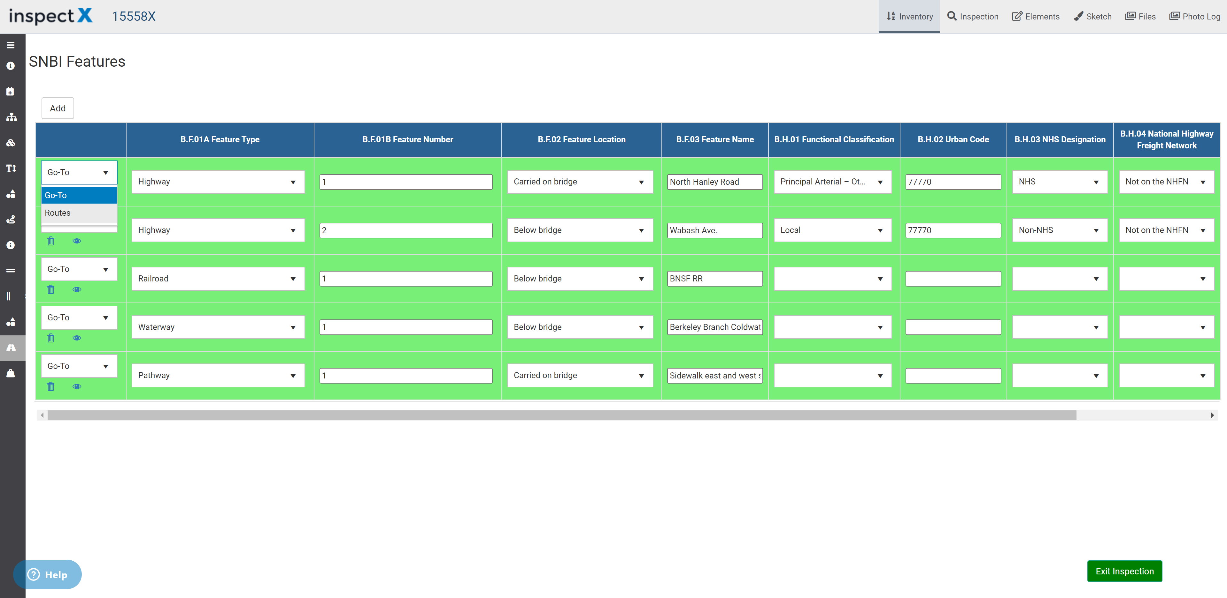
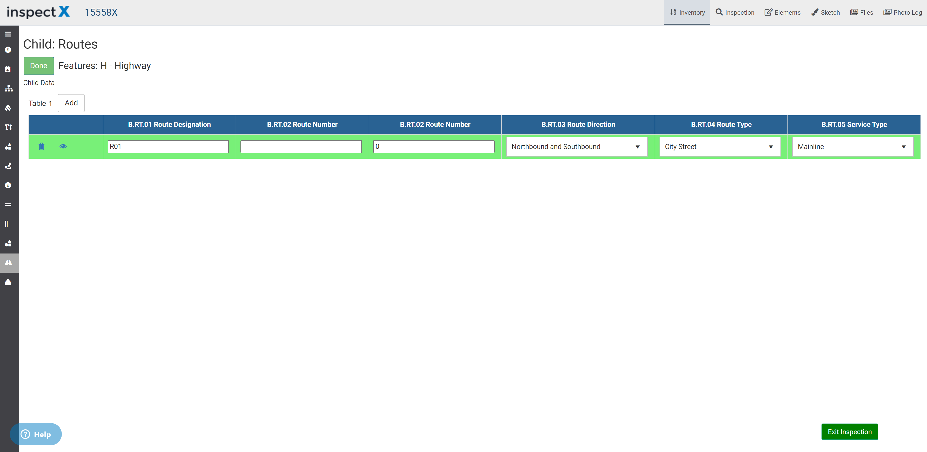
Features and Routes Data Set
inspectX Solution
Multiple ways to input data
Horizontal scroll bar
Detailed form view
Support parent - child relationship type tables
Ability to assign photos
Can also add state fields

Slide 34
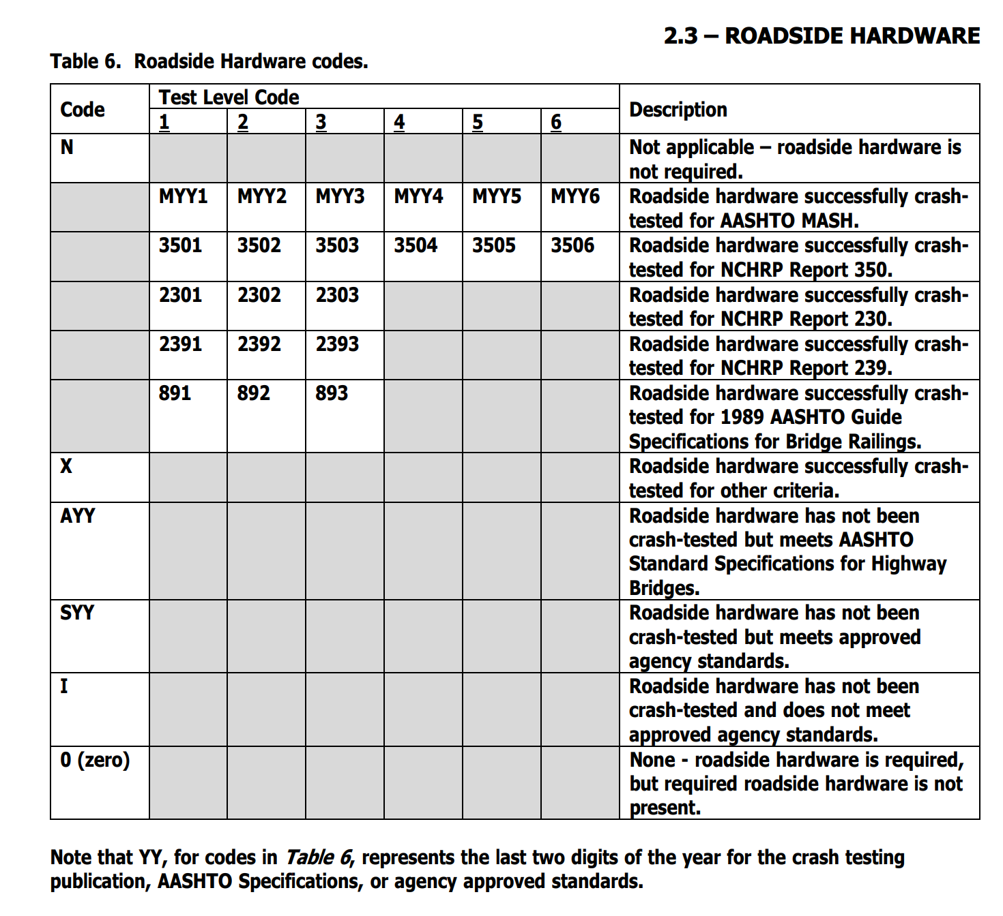
Roadside Hardware
No longer using Item 36 Traffic Safety Features
Required to collect detailed crash test data
Many had concerns with the level of effort
Lack of familiarity from bridge inspectors
Chart is not easy to follow

Slide 35
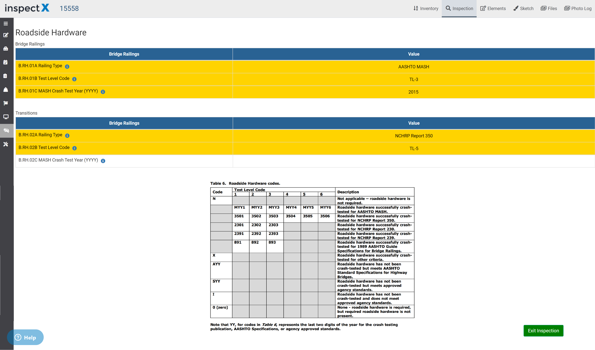
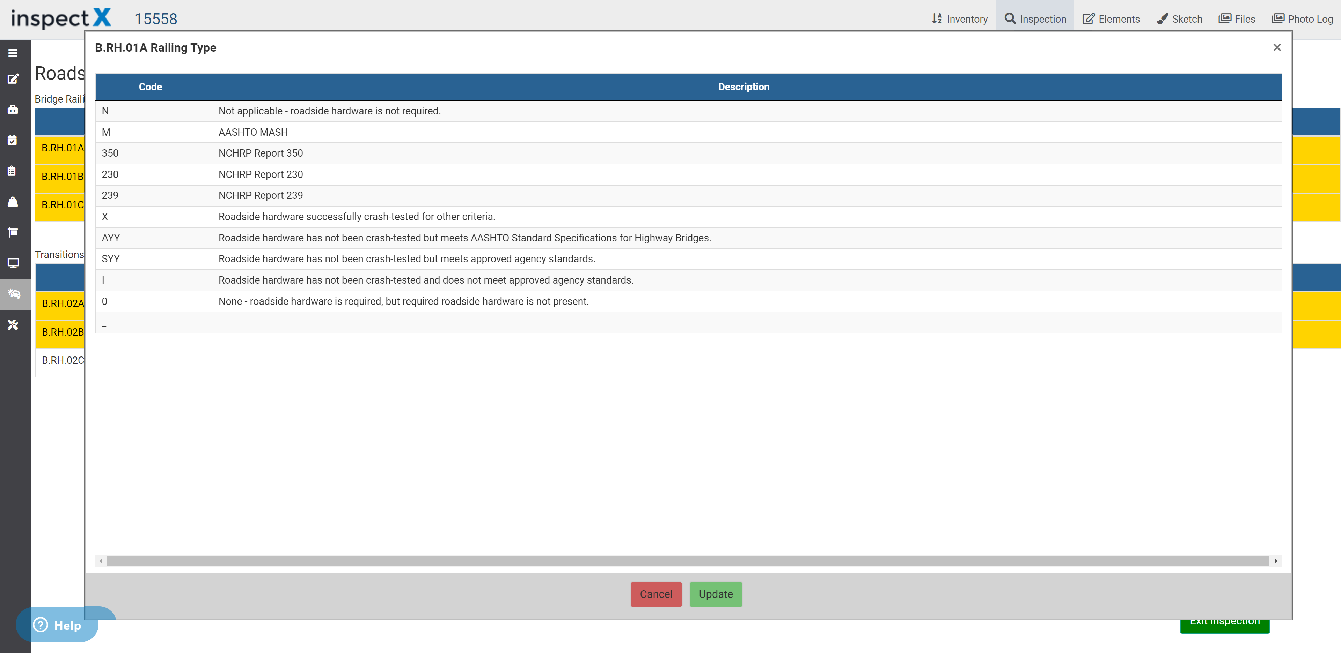
Roadside Hardware
inspectX Solution
Can incorporate chart to UI
Inspectors can easily reference
Better to break down the field
Railing Type
Test Level Code
Relevant Year
Auto-convert format for tape
i.e.. Mash, TL3, 2018 -> M183

Slide 36
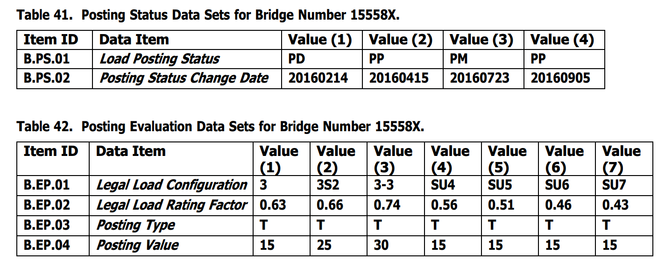
Posting Status and Evaluation Data Sets
Both Posting Status and Evaluation will be a subset of the Primary data
Data collection does not necessary follow inspection cycle
Inspection → Load Rating → Posting
Agencies are responsible for tracking posting status change date

Slide 37
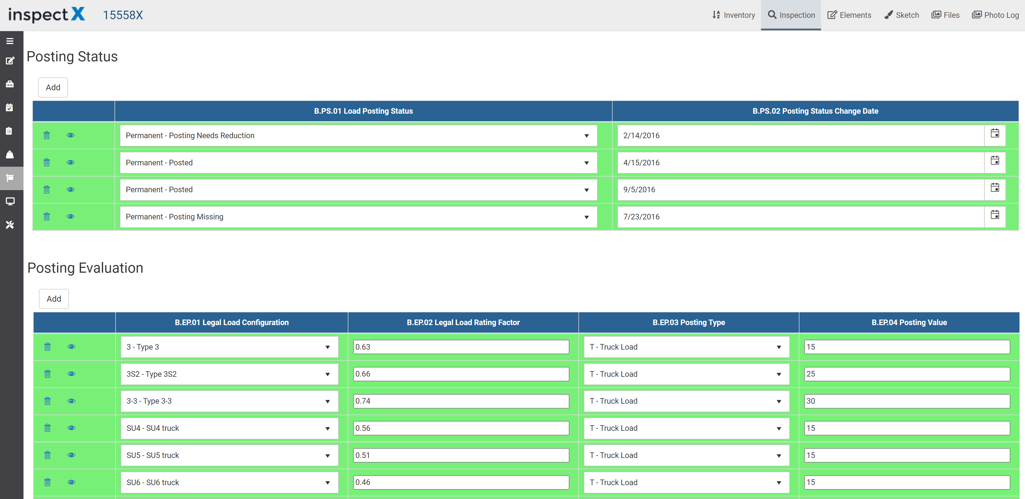
Posting Status and Evaluation Data Sets
inspectX Solution
Already supports data collection for posting status and evaluation
Allows users to create load rating and posting inspection types
Update load rating and posting data at any time

Slide 38
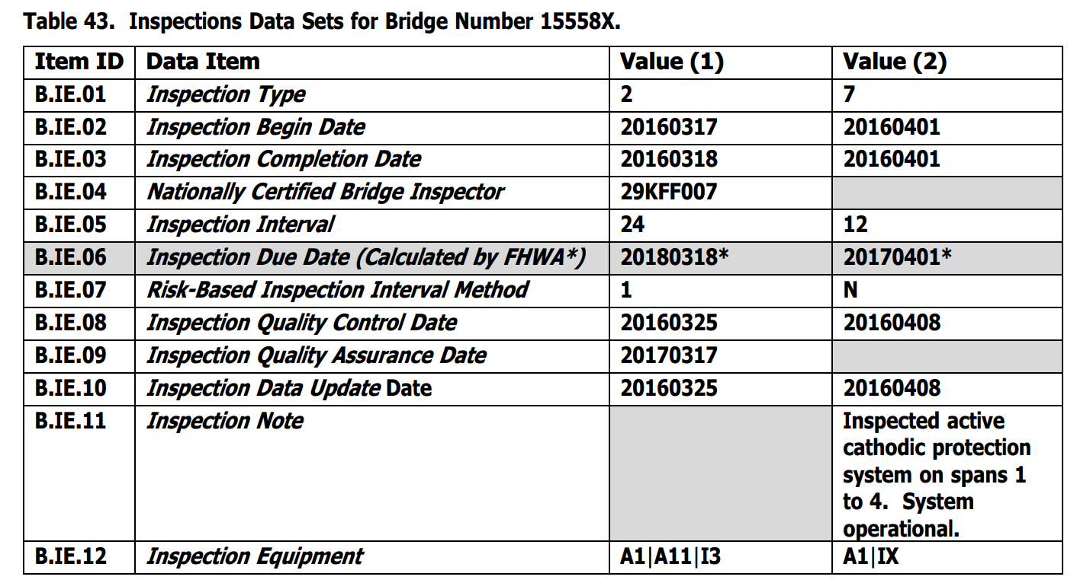
Inspection Data Sets
Increase in requirements
More dates for owners to keep track
Inspection Begin Date
Inspection Completion Date
Inspection Update Date
Quality Control Date
Quality Assurance Date
Track equipment for each inspection
Report relevant inspection notes

Slide 39
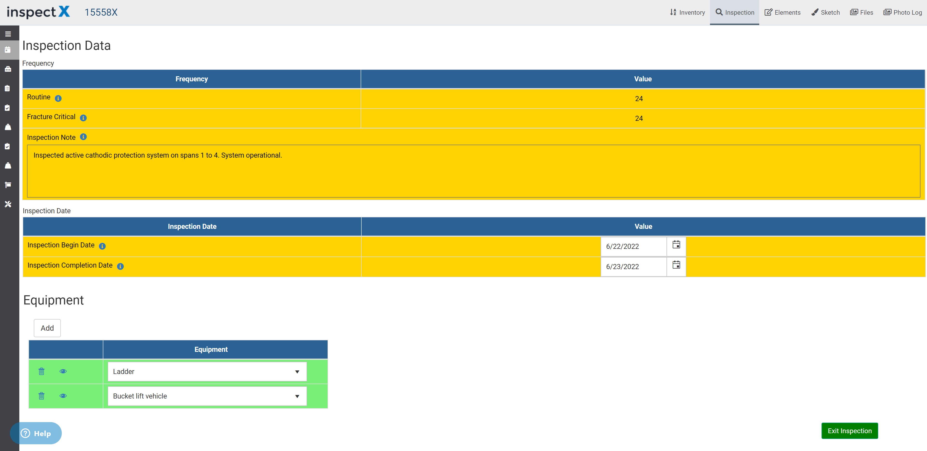
Inspection Data Sets
inspectX Solution
Revamping the inspection date page
Automatically log dates for tape
QC/QA/Update
inspectX allows QA inspection type
Track inspection equipment
AND allows you to query!
i.e.. Show me all bridges that require a snooper
Improve schedule planning

Slide 40
Work Data Sets
Required to report work performed each year
Many agencies track activities separately
Can be extra work for agencies to incorporate this data

Slide 41
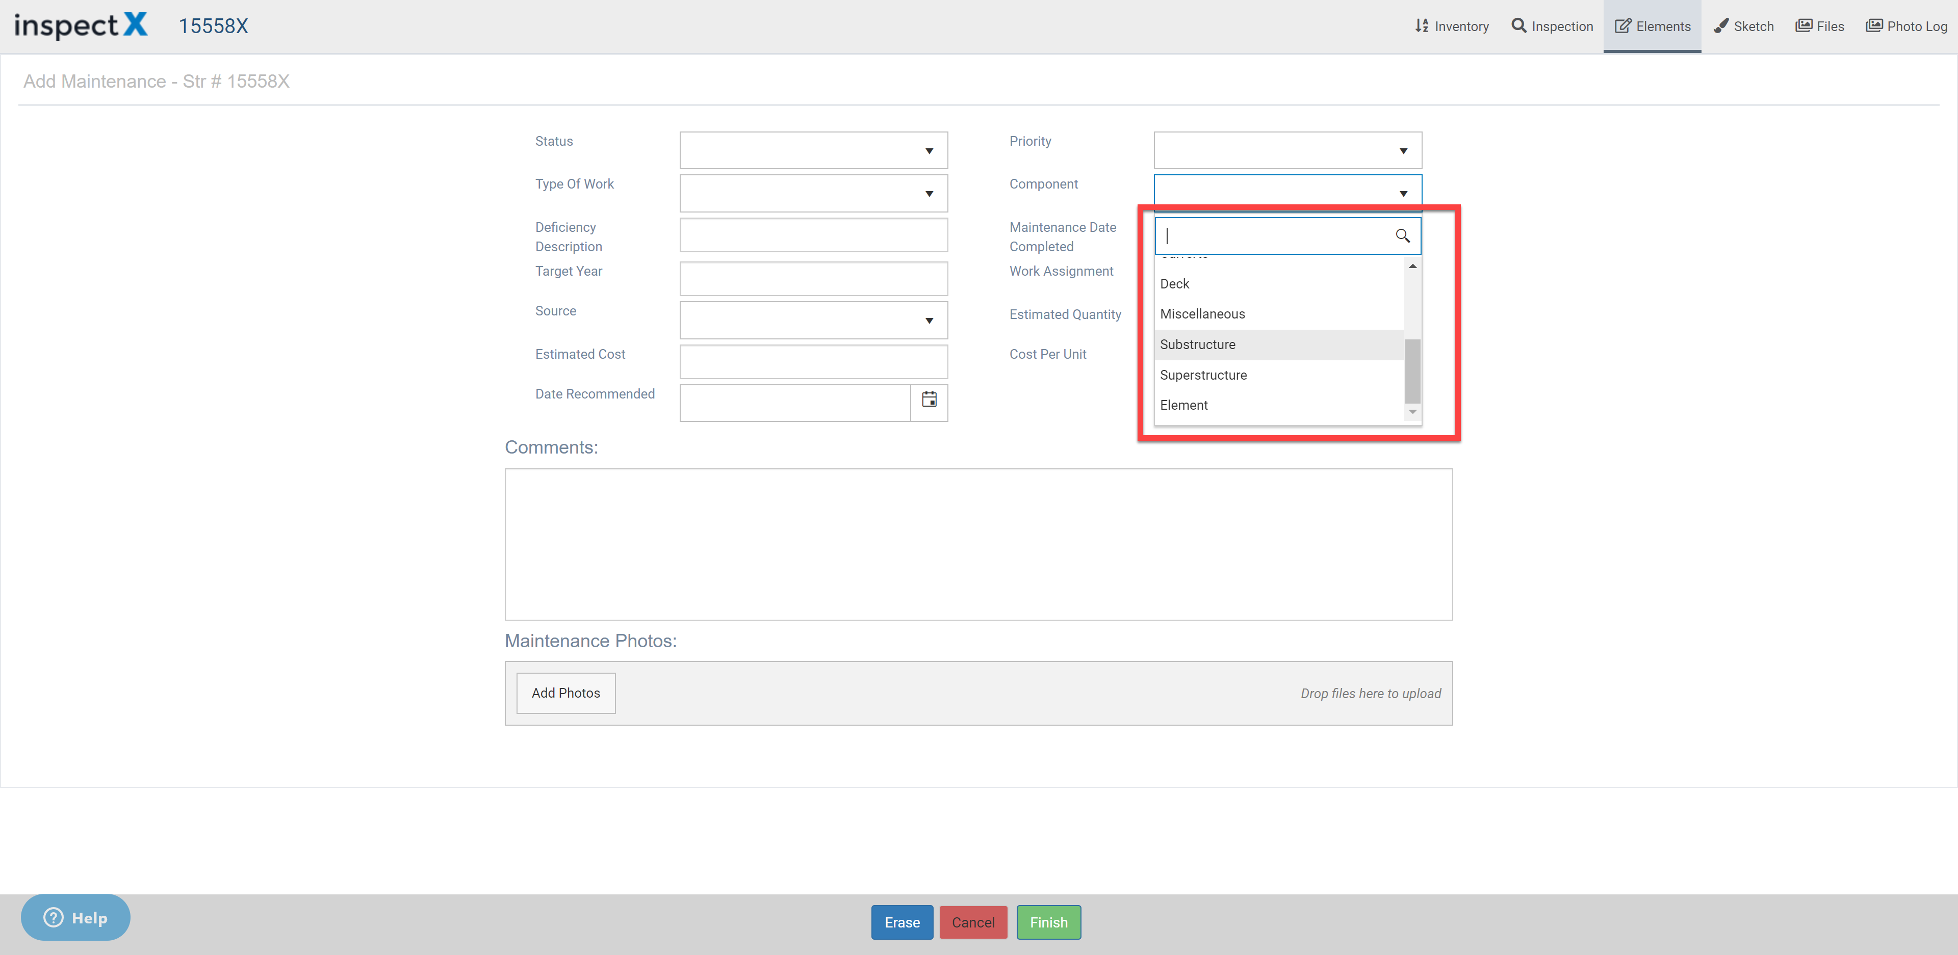
Work Data Sets
inspectX Solution
Already support a maintenance section to track such data
Agencies can configure fields to document work items
Already divide into categories (deck/super/sub/culvert..etc.)
Will include additional codes from SNBI
All of our existing clients already use it
For non-clients
We can migrate your maintenance data

Slide 42
Summary

Slide 43
Summary
The new inspectX is ready to take on the new NBIS and SNBI challenges
In the process of transitioning our clients to the new version
Any new clients will be onboarded to the new version
Support both NBI and SNBI data collection at the same time!
Transition at your own pace
Will convert NBI → SNBI for clients once the crosswalk is available
Many of the processes can be automated, less burden on the agencies
Don’t wait, start the SNBI transition ASAP
We want your feedback! Many of the great ideas came from you

Slide 44
Q & A

Slide 45
Upcoming Webinars

Slide 46
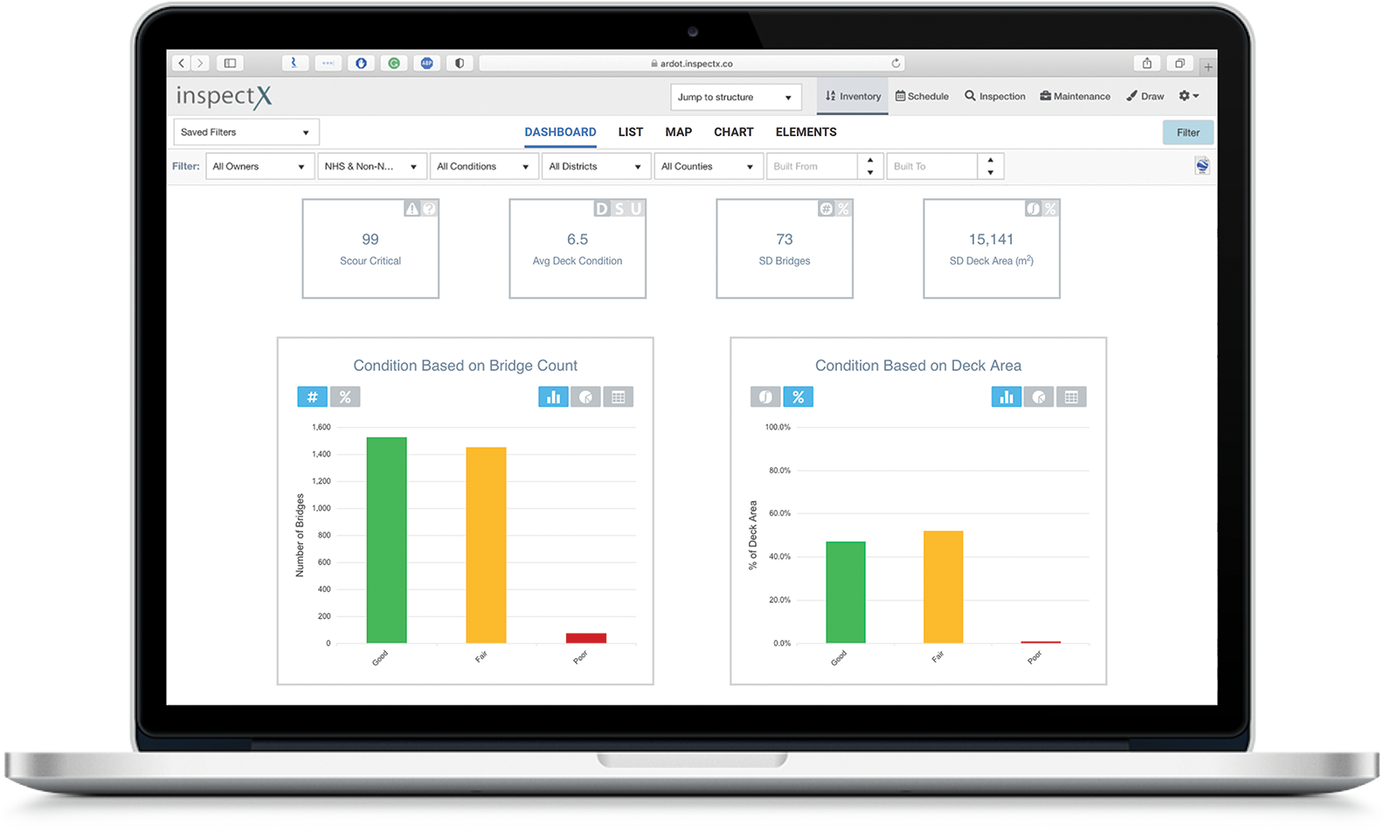
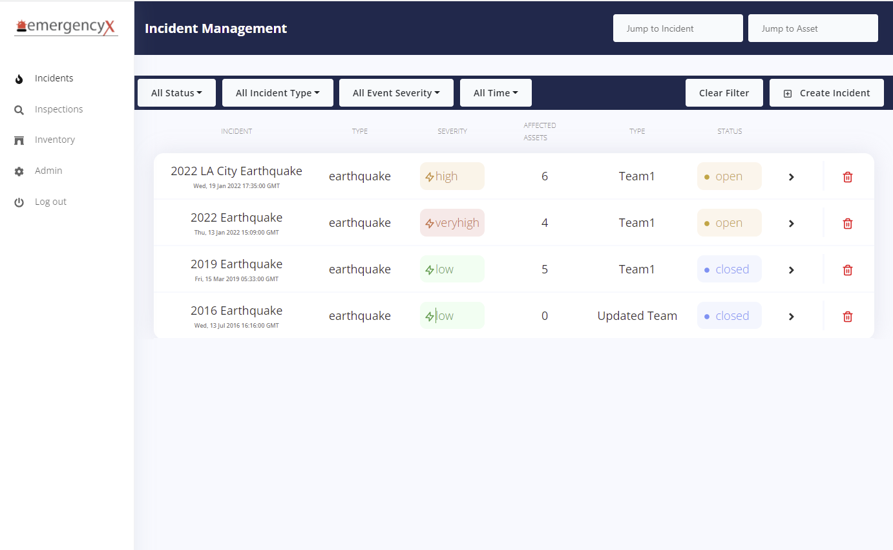
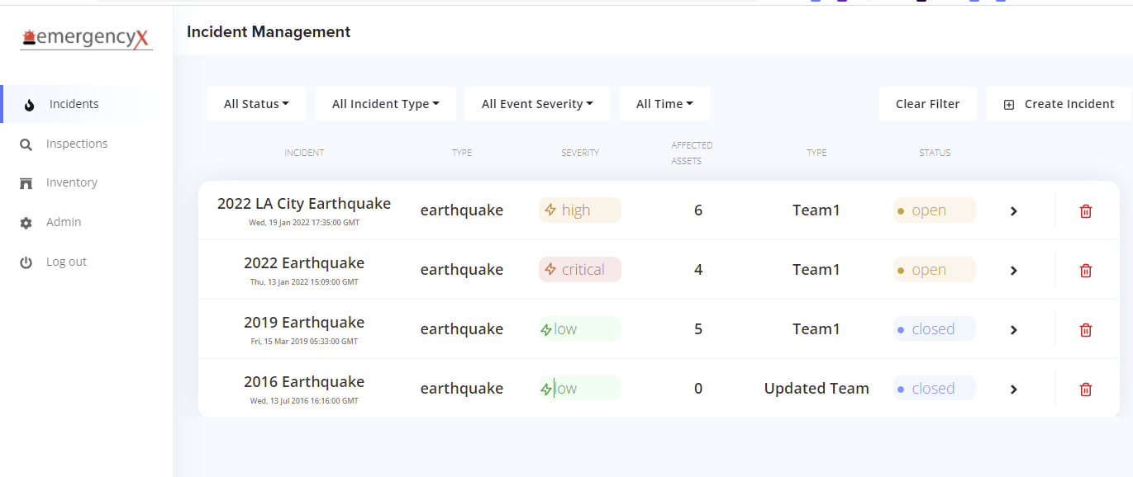
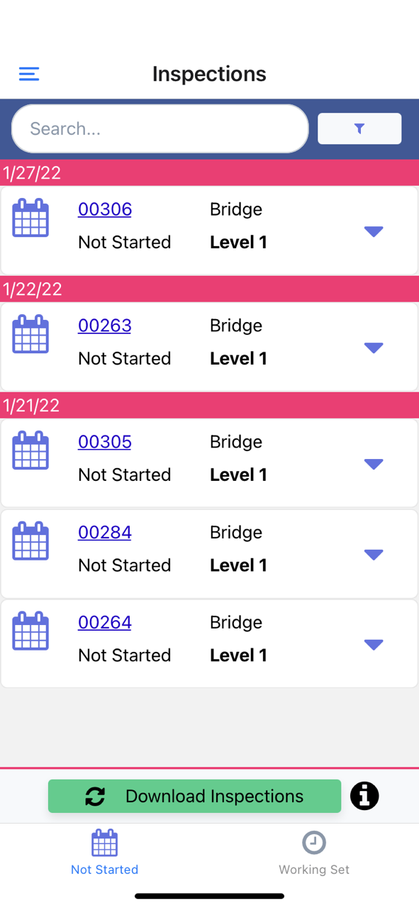
Upcoming Webinars
Monitor and Respond to Floods & Earthquakes Events

Slide 47
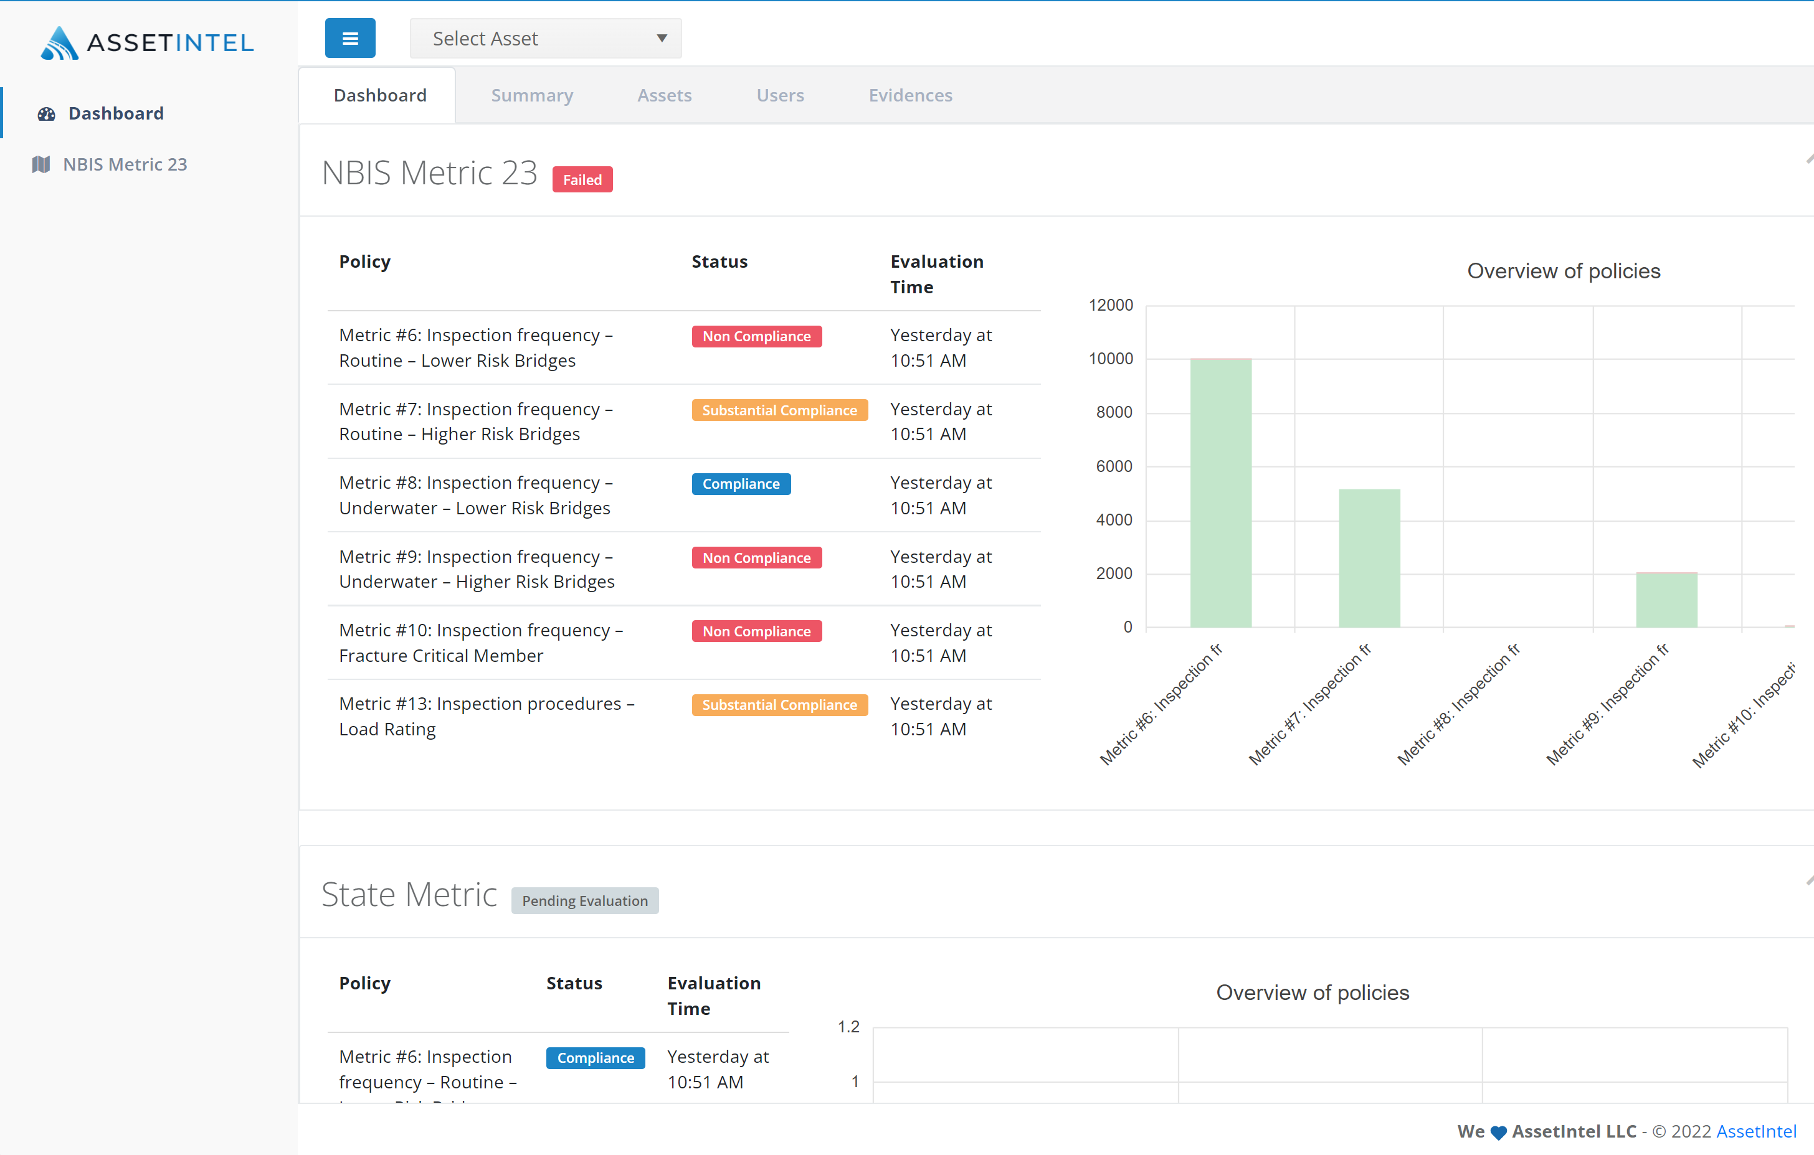
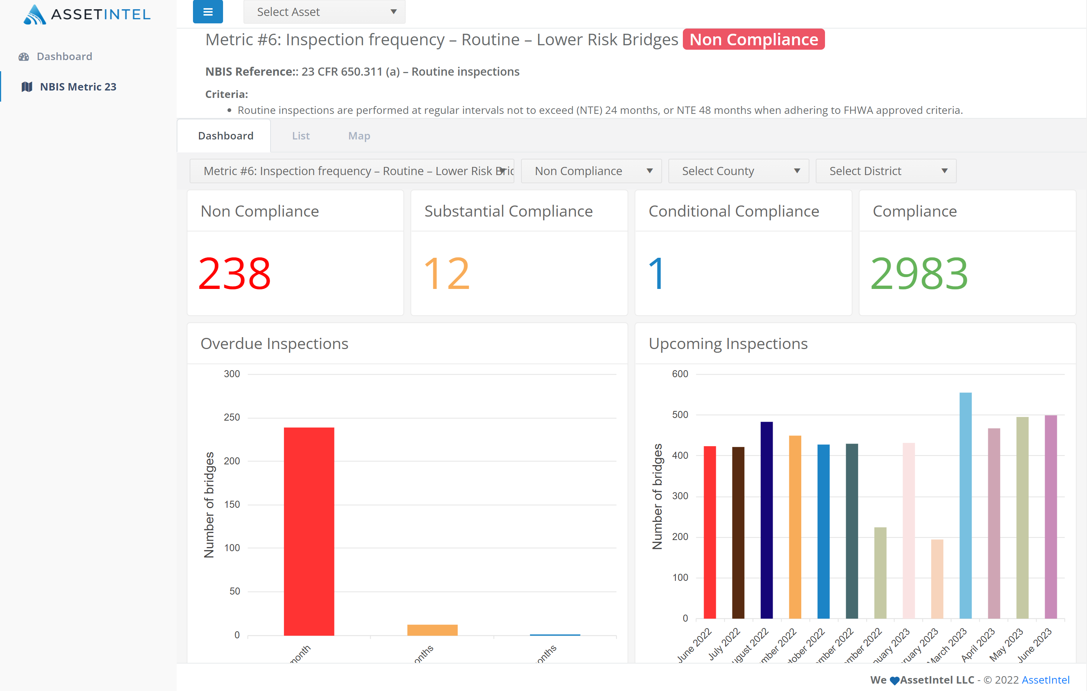
Upcoming Webinars
Metric Compliance Module

Slide 48
Thank You
KENNY TONG
CUSTOMER SUCCESS MANAGER
ktong@bridge-intel.com

