Slide 1
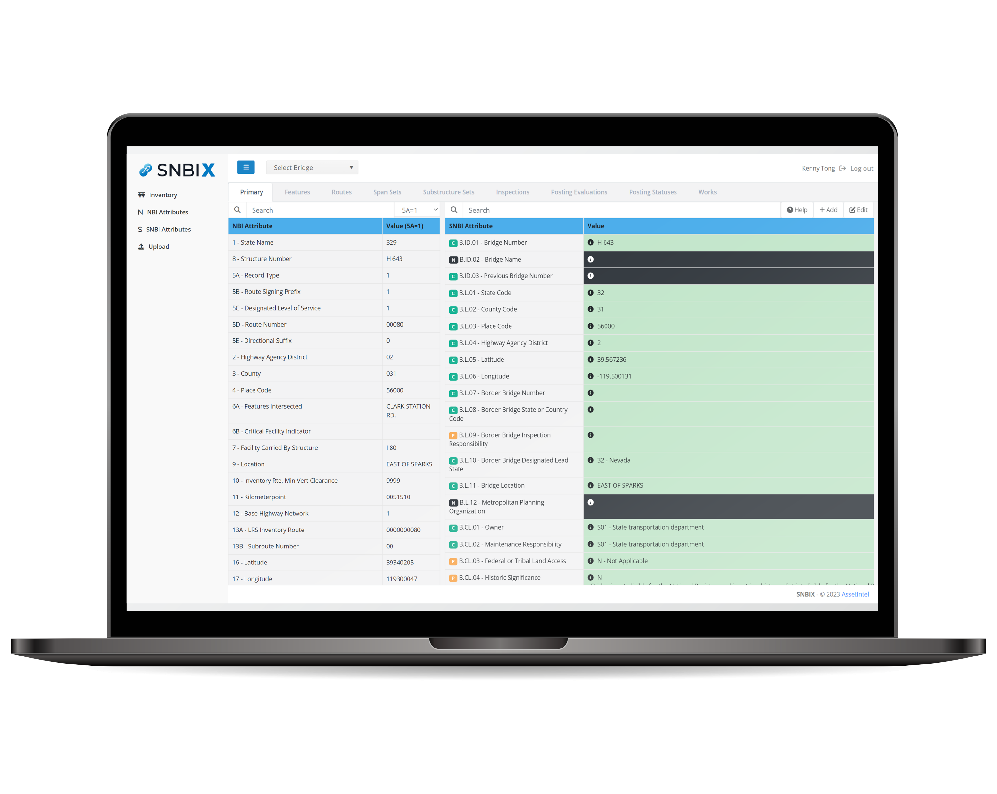
SNBI Transition
Tool for Everyone
Notes:
20 State Agencies including (Forest Service and Army Corp) + FHWA + Consultants

Slide 2
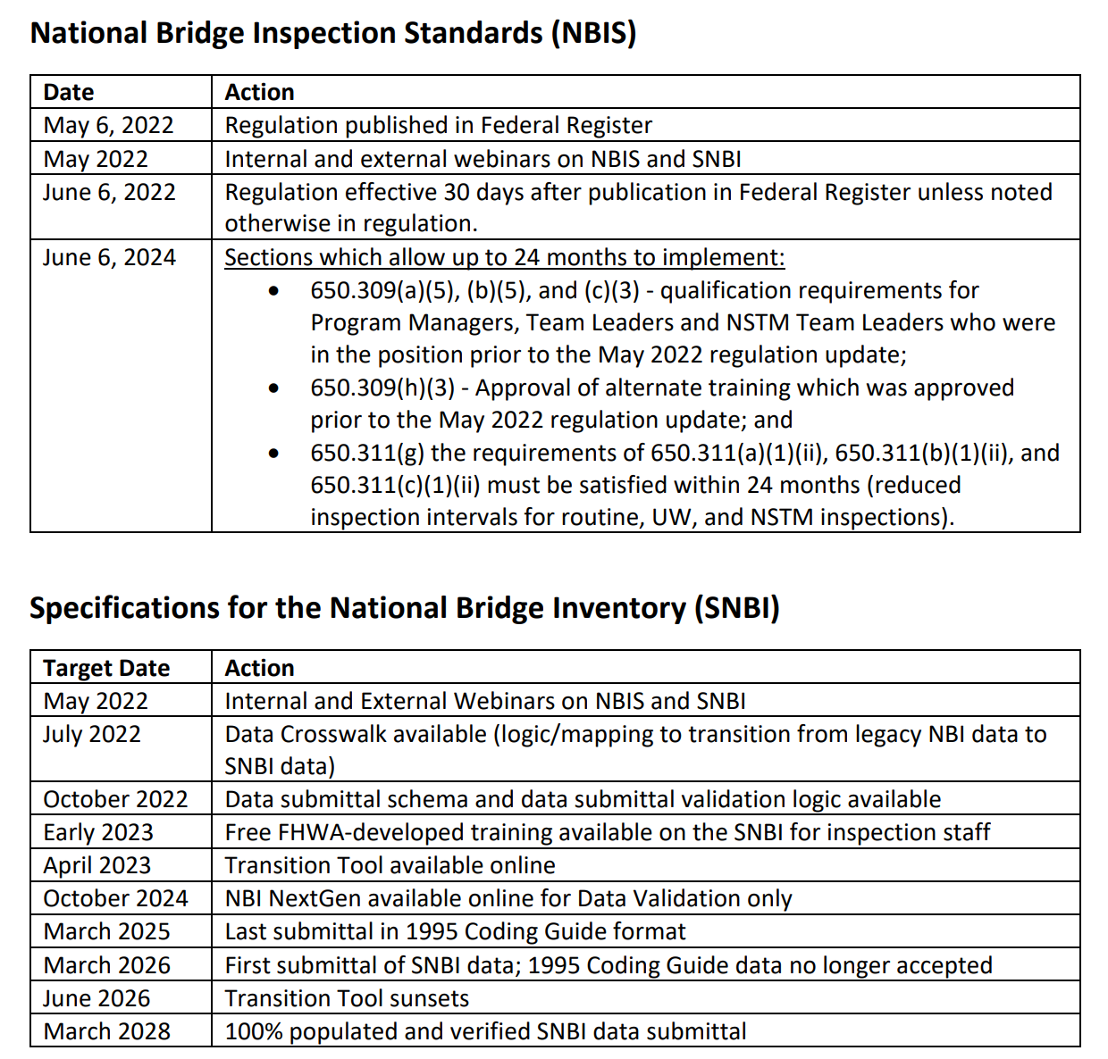
Looking Ahead
11 months since regulation is published!
Early 2023, Free FHWA SNBI Training will be available
April 2023, Transition tool will be available by FHWA (delayed)
June 2024, Implement qualification/interval requirements
57 months until 100% SNBI submittal deadline (March 2028)
Running out of time for bridges with 48-month cycle
Notes:
Just a little background. The new NBIS has been YEARS in the making. It went through many iterations OVER THE YEARS. The proposed rule finally came out in November of 2019. After a 30-month long hiatus, the final rule was published. The reg became effective in June. This is a huge milestone for FHWA.
??Which image is related to which bullet point??

Slide 3
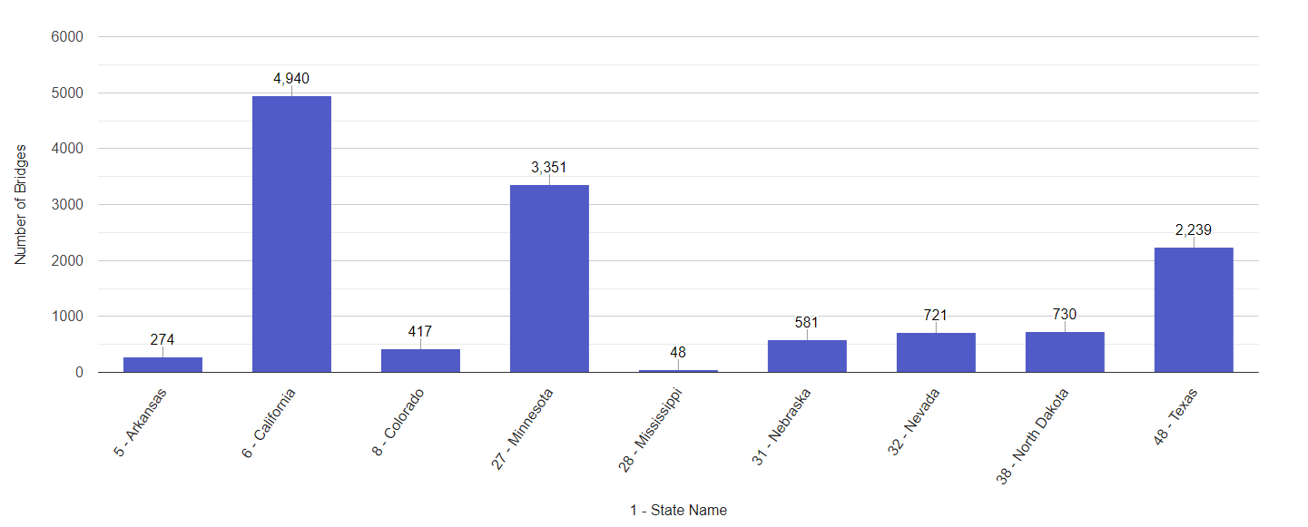
States with 48-month routine inspection cycles
*Data derived from FHWA Info Bridge
Notes:
500k to gain access in 2023
Otherwise in 2024

Slide 4
Poll Question
What method are you using to collect and store SNBI data?
inspectX
Excel
Access
In-house software
Have not started
Notes:
500k to gain access in 2023
Otherwise in 2024

Slide 5
SNBI Transition Challenges

Slide 6
Software Challenges
The new regulation can be a huge burden on all software in the market
AASHTO BrM – Version 7.0 is being delayed to mid 2023
Users who did not pay $500k will get access a year later
AssetWise – Planning for early 2024
inspectX – Had to completely rebuild the software and has been SNBI ready
In-house software – Require significant development resources
Many agencies still do not have a platform to collect and store the new SNBI data
Notes:
Supposed to come out in March, it is now being delayed to mid 2023

Slide 7
Excel/Access Limitations
Some agencies are resorting to Excel/Access for SNBI data collection, but this has its limitations:
Performance Issues – Speed degrades as data size increases
Lack of Data Structure – Not meant to handle many-to-one data (ie. Features)
Lack of Data Integrity – Allow data input in a free-form manner, prone to errors
Limited Collaboration – Challenging when multiple users need to access simultaneously
Data Loss – Prone to overwriting and deletion of data
Lack of Data Versioning – Difficult to know who changed what

Slide 8
Increase in Cost and Labor
Many agencies are experiencing high turnover in inspection staff
Retirement
Hired by consultants
Significant increase in time and cost for SNBI data collection
81 fields with no transition and partial transition
Implementation cost comments from NPRM
1 hr. to 10 hrs. per bridge
$200k to $18m per inventory
Some agencies are hiring consultants to do bulk of the data collection

Slide 9
Steep Learning Curve
Many agencies are waiting for more guidance from FHWA
Hesitant to start data collection in fear of misinterpretation
SNBI training is still in its pilot phase
Complicated crosswalk logic from NBI to SNBI
Require rewrite of inspection manuals and extensive internal training

Slide 10
FHWA Transition Tool
Benefits
Source of truth
Ability to import NBI tape
Convert clean and partial transitions
Provide JSON output
Potential Limitations
Require conversion from JSON to Excel
Not easy to do side-by-side comparison
Does not support agency fields to SNBI
One size fits all

Slide 11
Our Mission
Provide a standalone platform for any agencies to collect SNBI data
Offer data visualization and analytics for such complex set of data
Allow side-by-side comparison between NBI and SNBI
Support multi-user collaboration
Support transition logic based on the FHWA crosswalk
Provide seamless import and export functionalities
Allow agencies to stage their SNBI data before going to production

Slide 12
SNBIX
Transition Tool for Everyone

Slide 13
Let the software do the work for you
Import NBI Tape
Automated Transition
Import FHWA Transition
Review Data
Add/Edit Data
Export SNBI Data
No data processing is required from your end!

Slide 14
Smooth Transition
Start by importing your NBI tape
SNBIX has a built-in transition logic per the crosswalk
Automatically transition your NBI tape to SNBI
Upload FHWA Transition JSON if so desired
Will overwrite the internal transition values

Slide 15
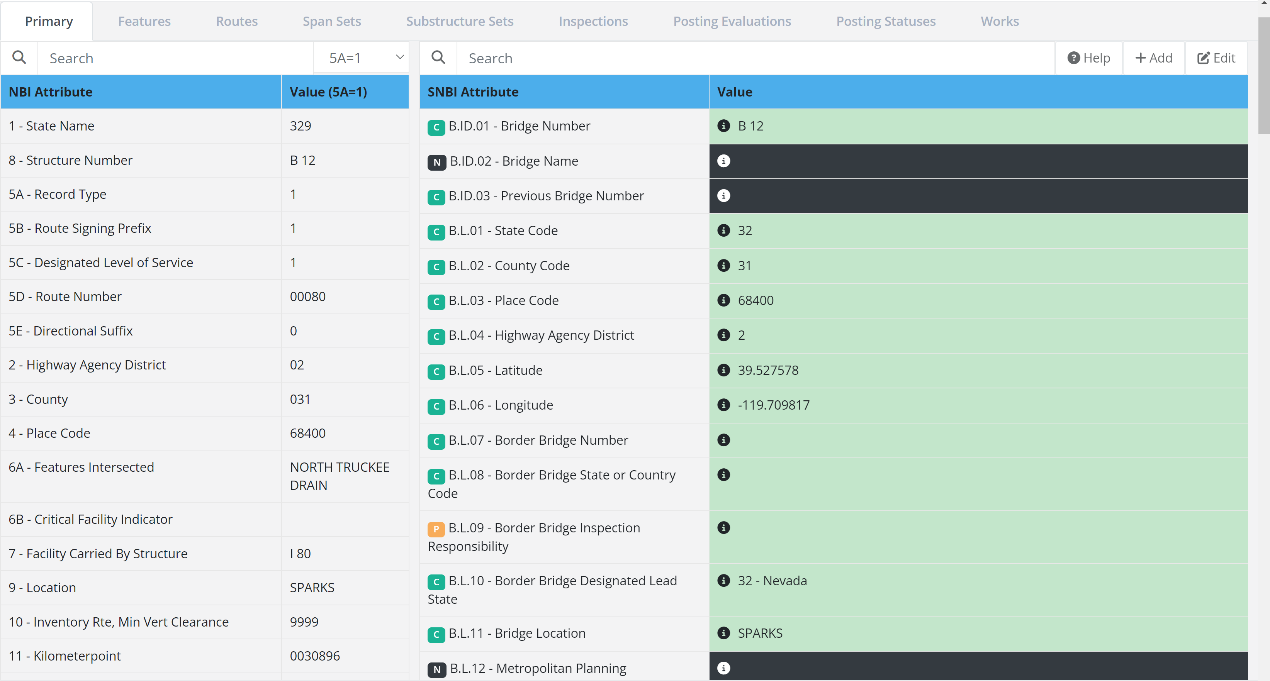
The Power of Data Visualization
Allow side-by-side comparison between NBI and SNBI
NBI
SNBI

Slide 16
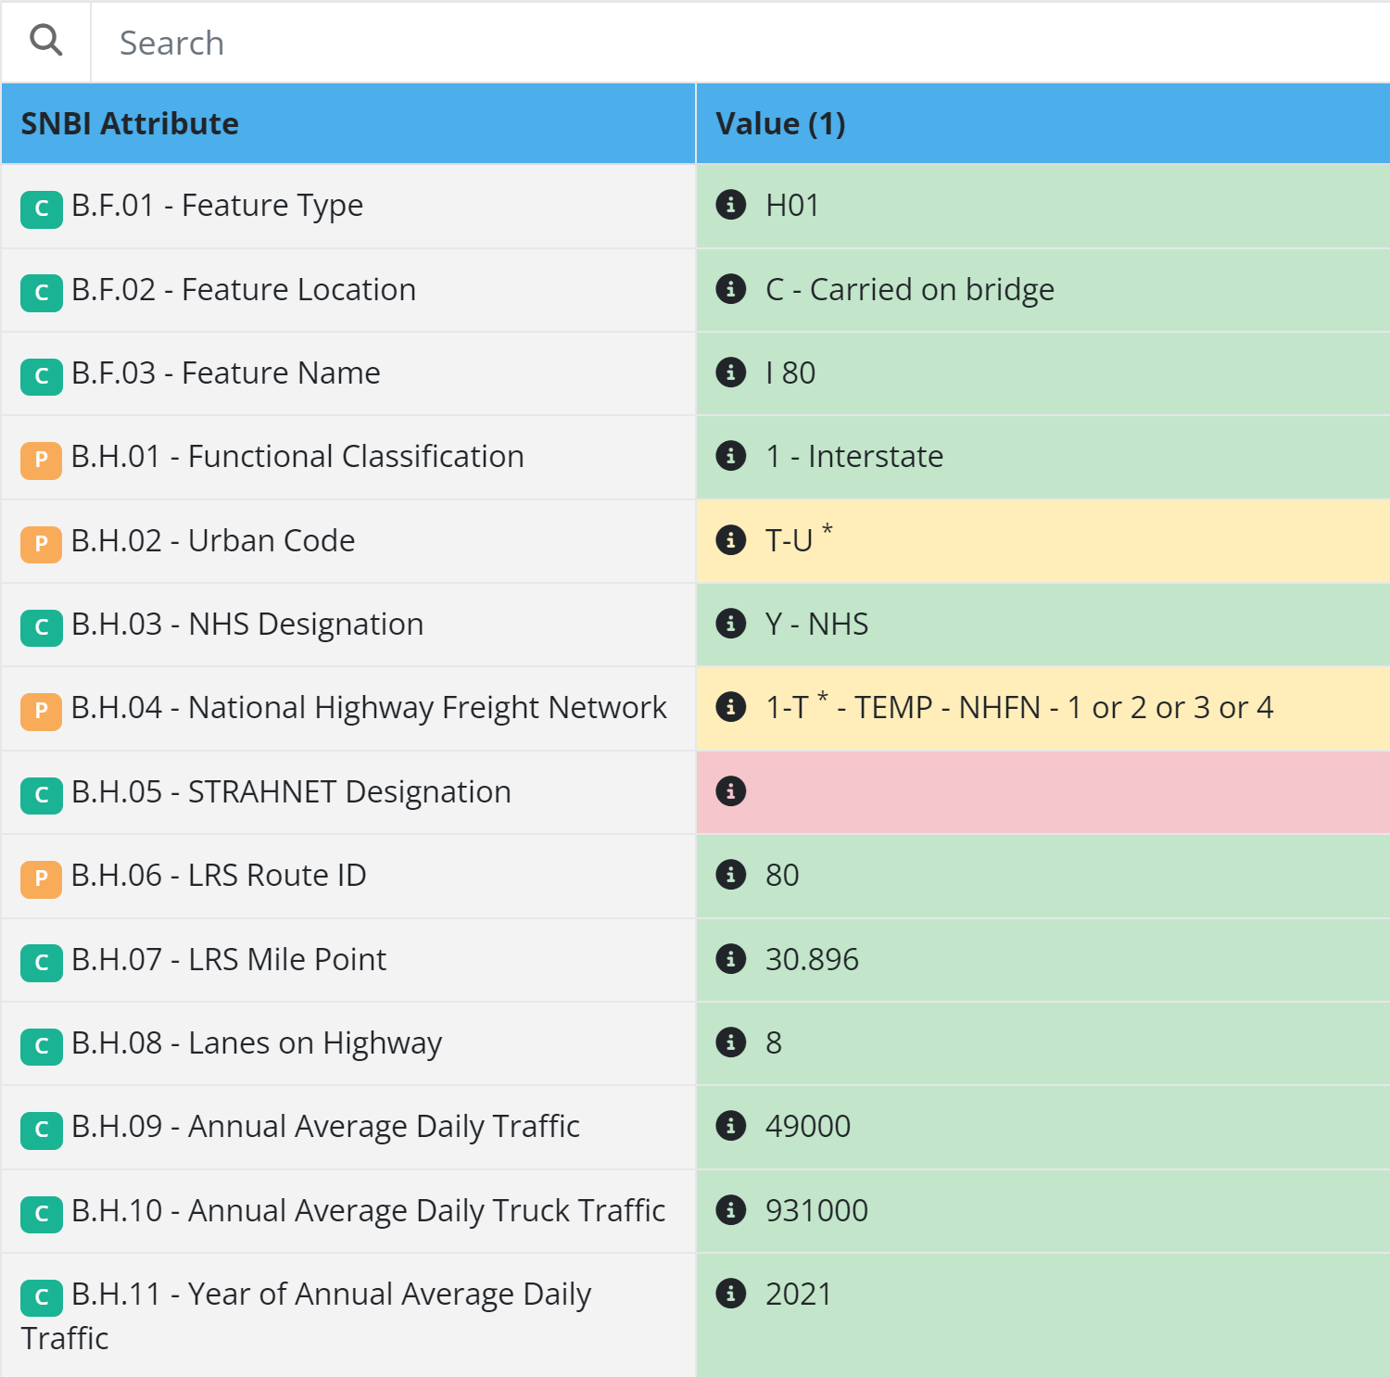
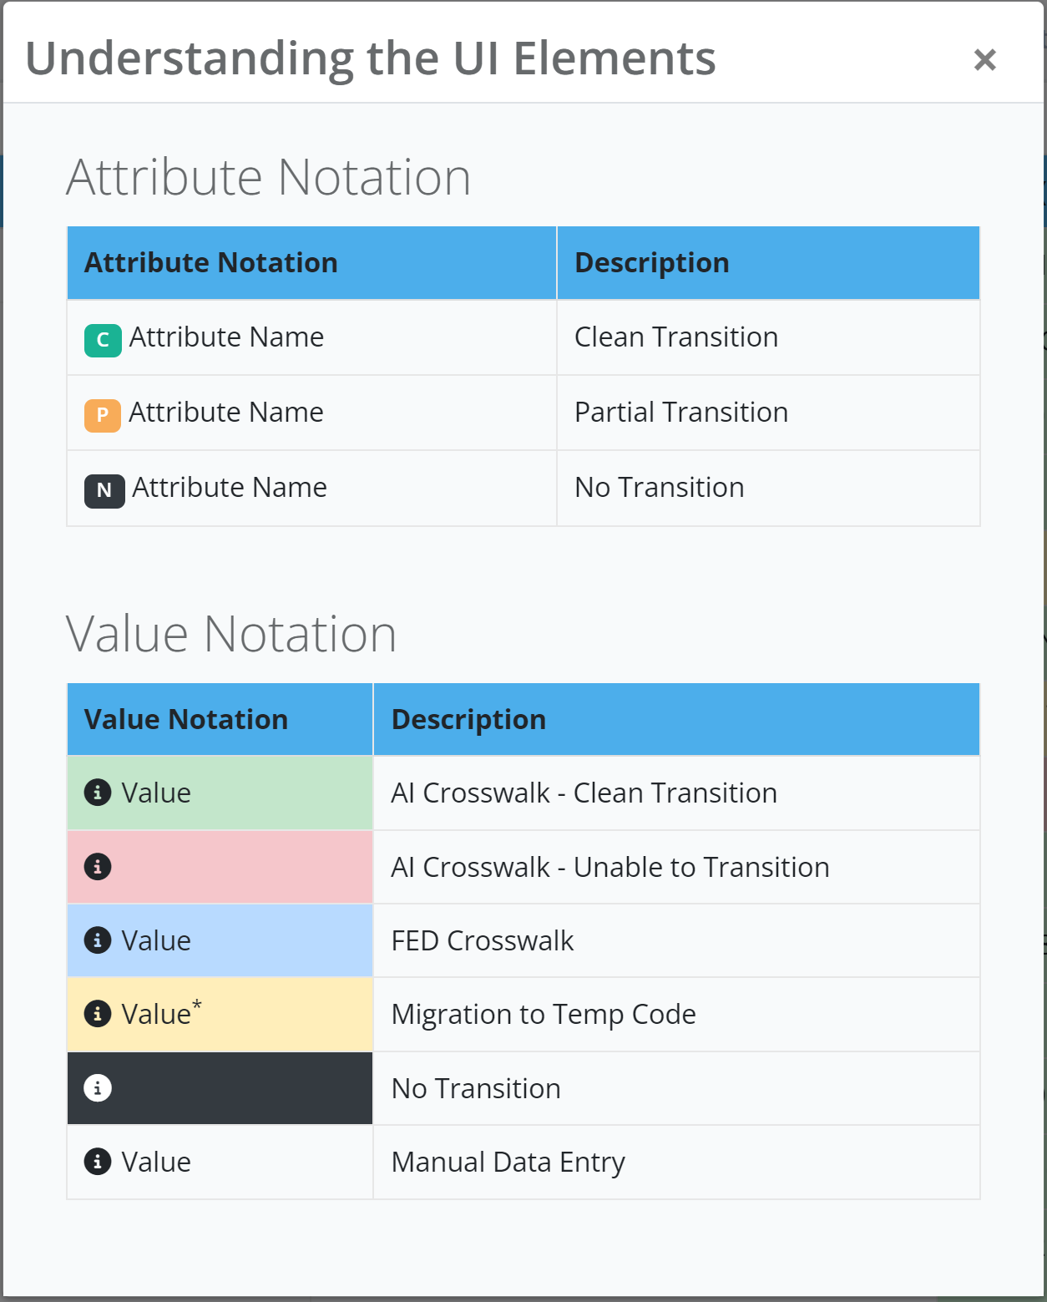
The Power of Data Visualization
Allow side-by-side comparison between NBI and SNBI
Data transition is tagged and color-coded

Slide 17
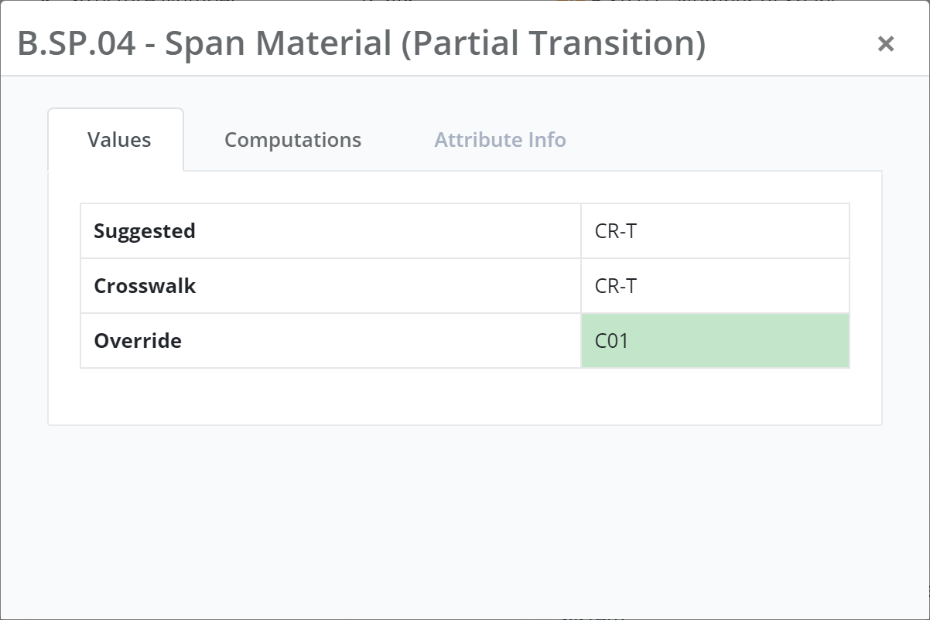
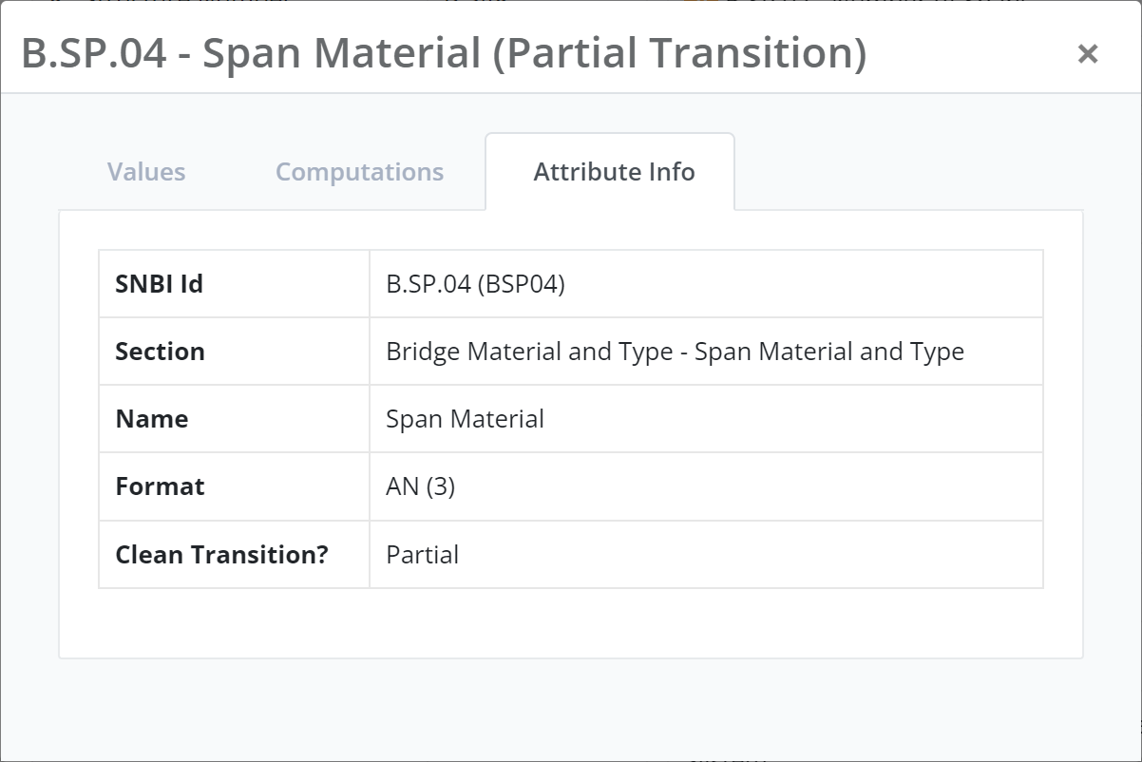
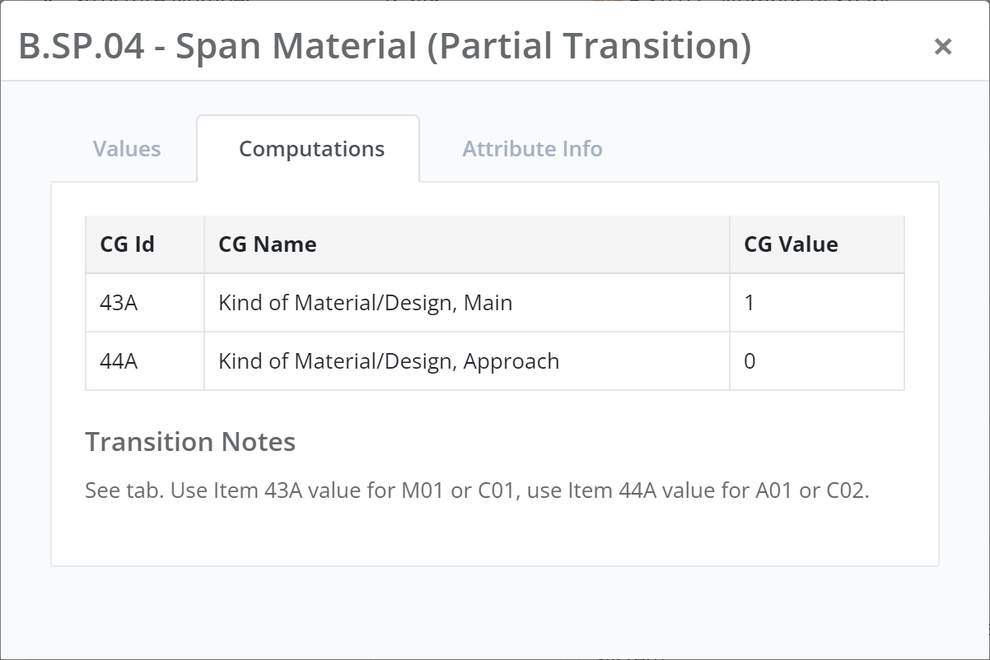
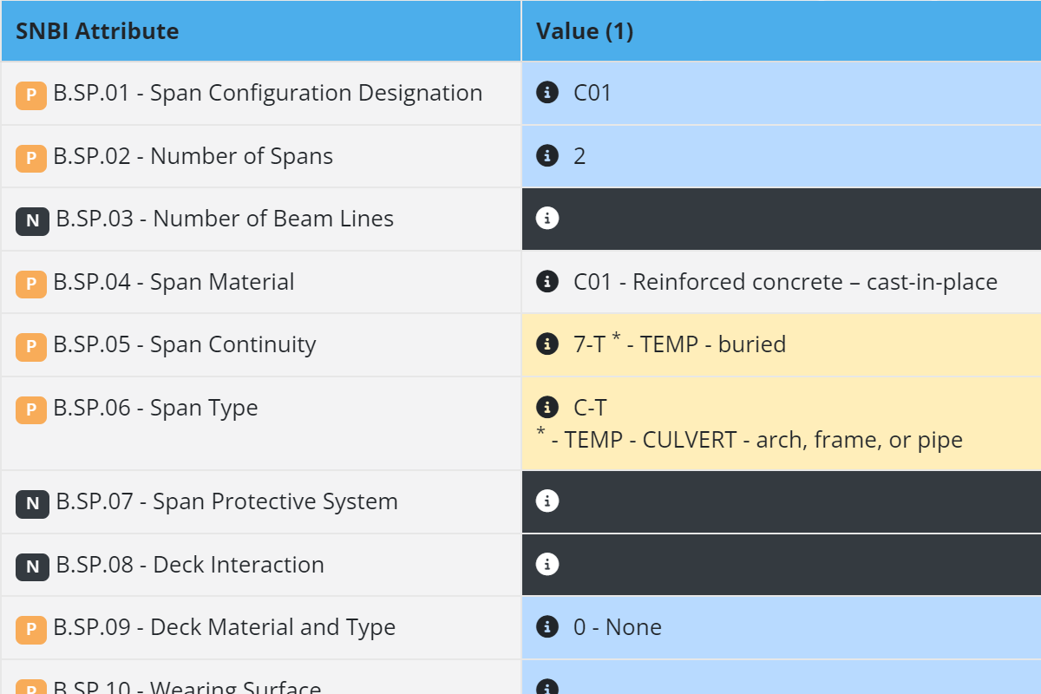
The Power of Data Visualization
Allow side-by-side comparison between NBI and SNBI
Data transition is tagged and color-coded
Reference the crosswalk and the SNBI manual

Slide 18
Data Visualization Benefits
Transform complex data and logic to understandable chunks
Enhance understanding and communication
Provide users everything they need in one place
Improve overall efficiency compared to using raw data

Slide 19
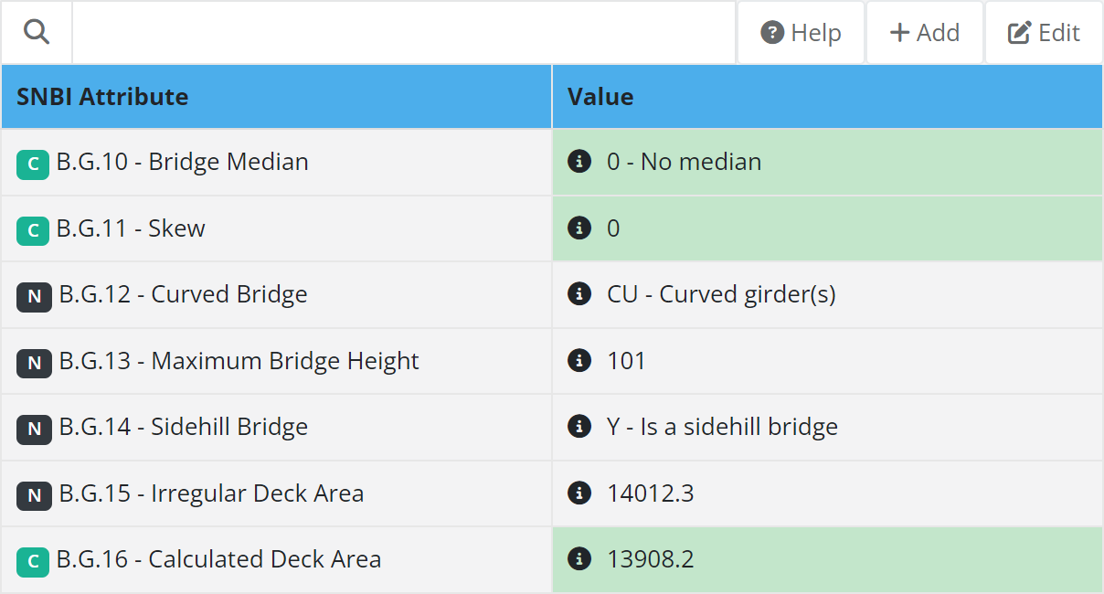
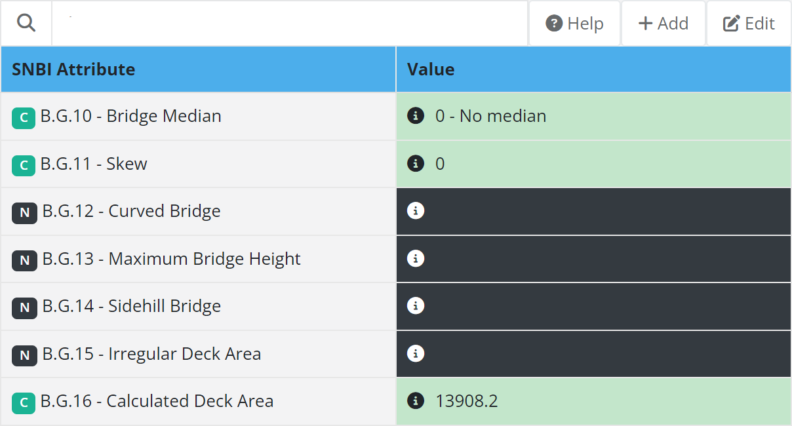
SNBI Data Collection
Complete the missing data
Total of 48 SNBI fields with no transition

Slide 20
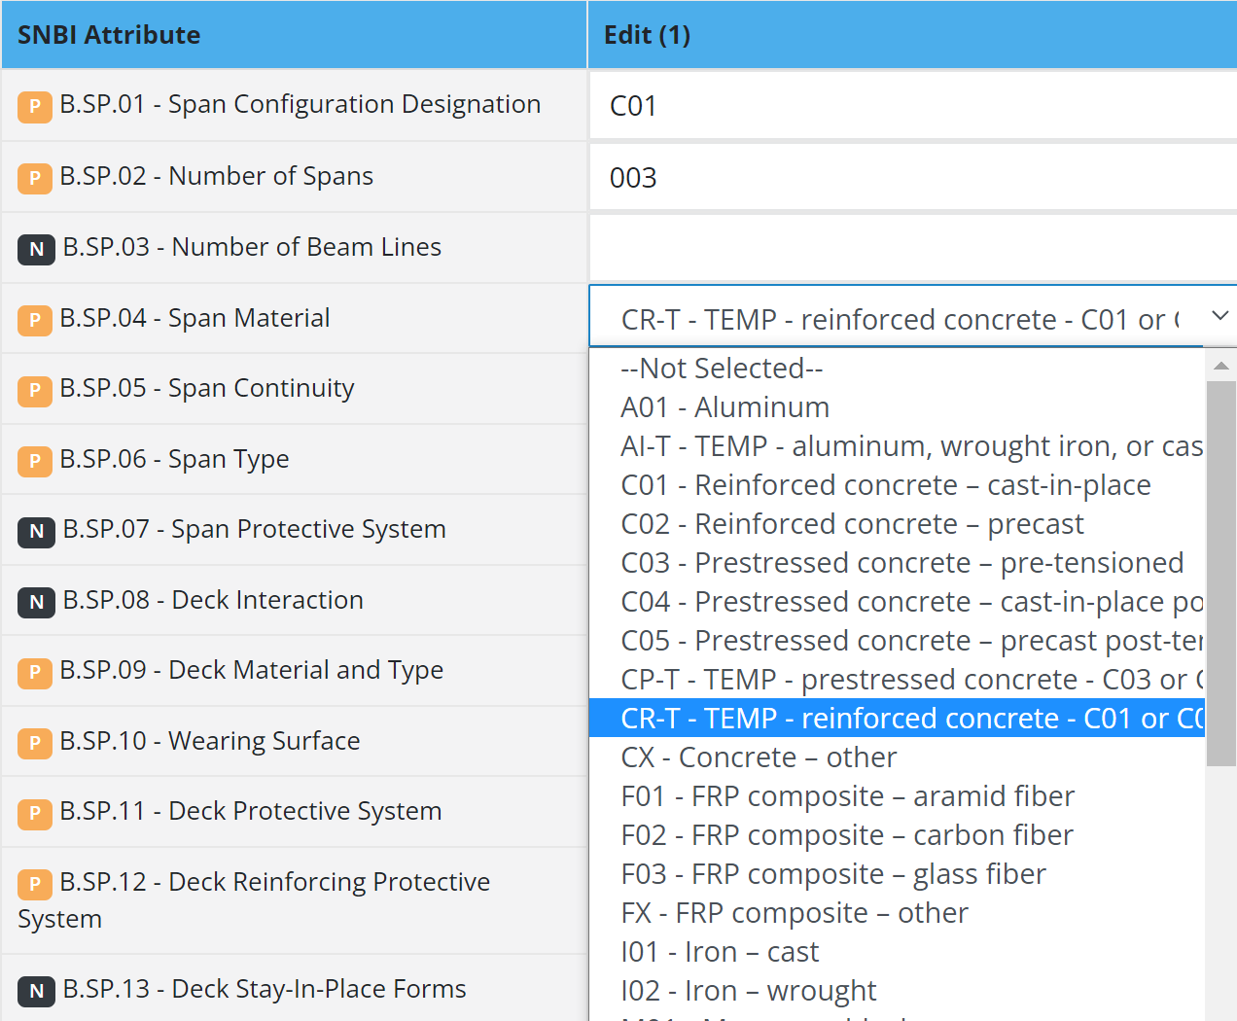
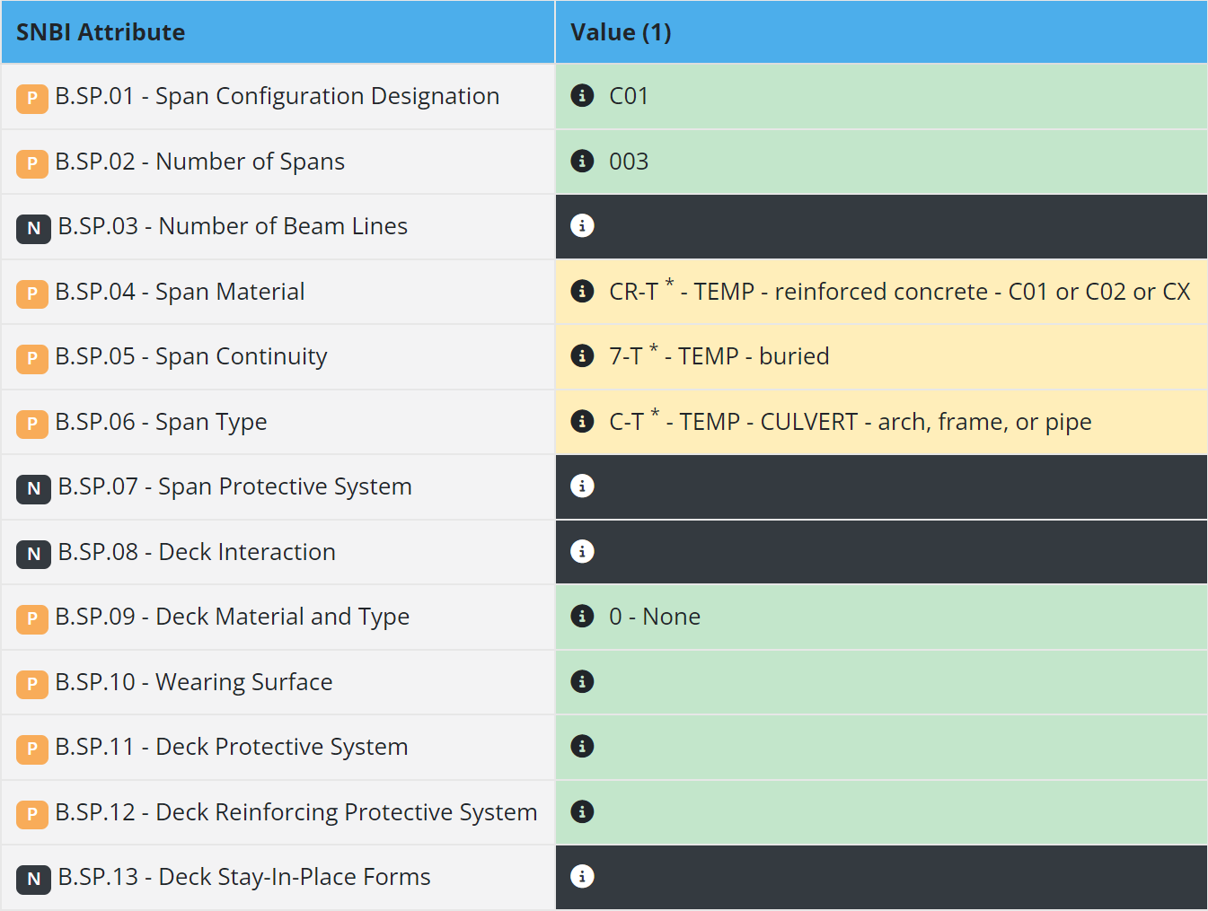
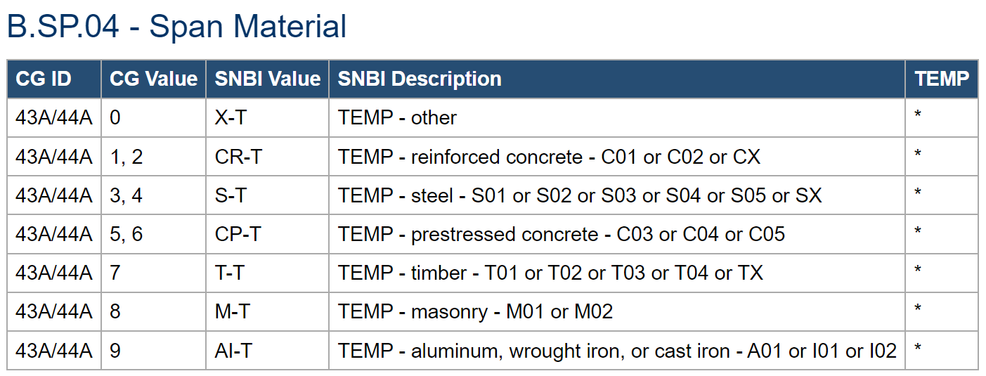
SNBI Data Collection
Complete missing data
Overwrite transitioned data (i.e. temp codes)
Some Coding Guide codes do not transition into a permanent SNBI code but may transition into a temporary code "-T“. (FHWA Crosswalk)

Slide 21
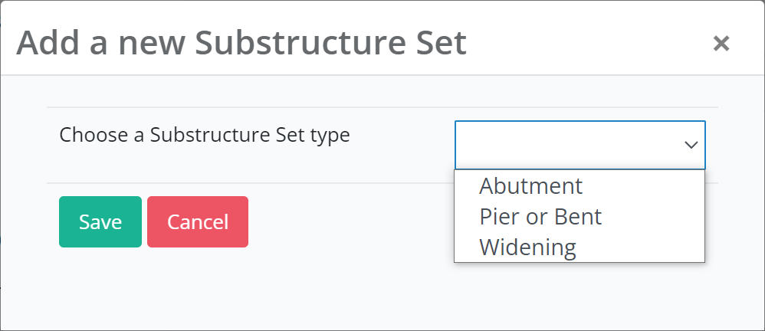
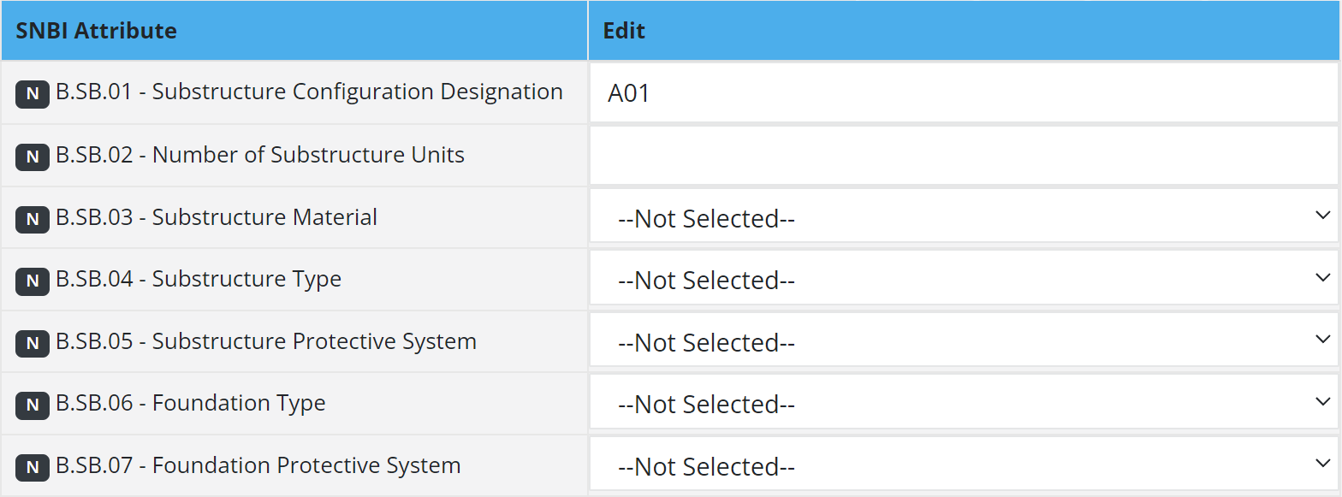
SNBI Data Collection
Add missing data (ie. no transition fields)
Overwrite transitioned data (ie. temp codes)
Add required many-to-one data (ie. substructure sets)
Substructure data set has no transition from NBI
Need to start from scratch

Slide 22
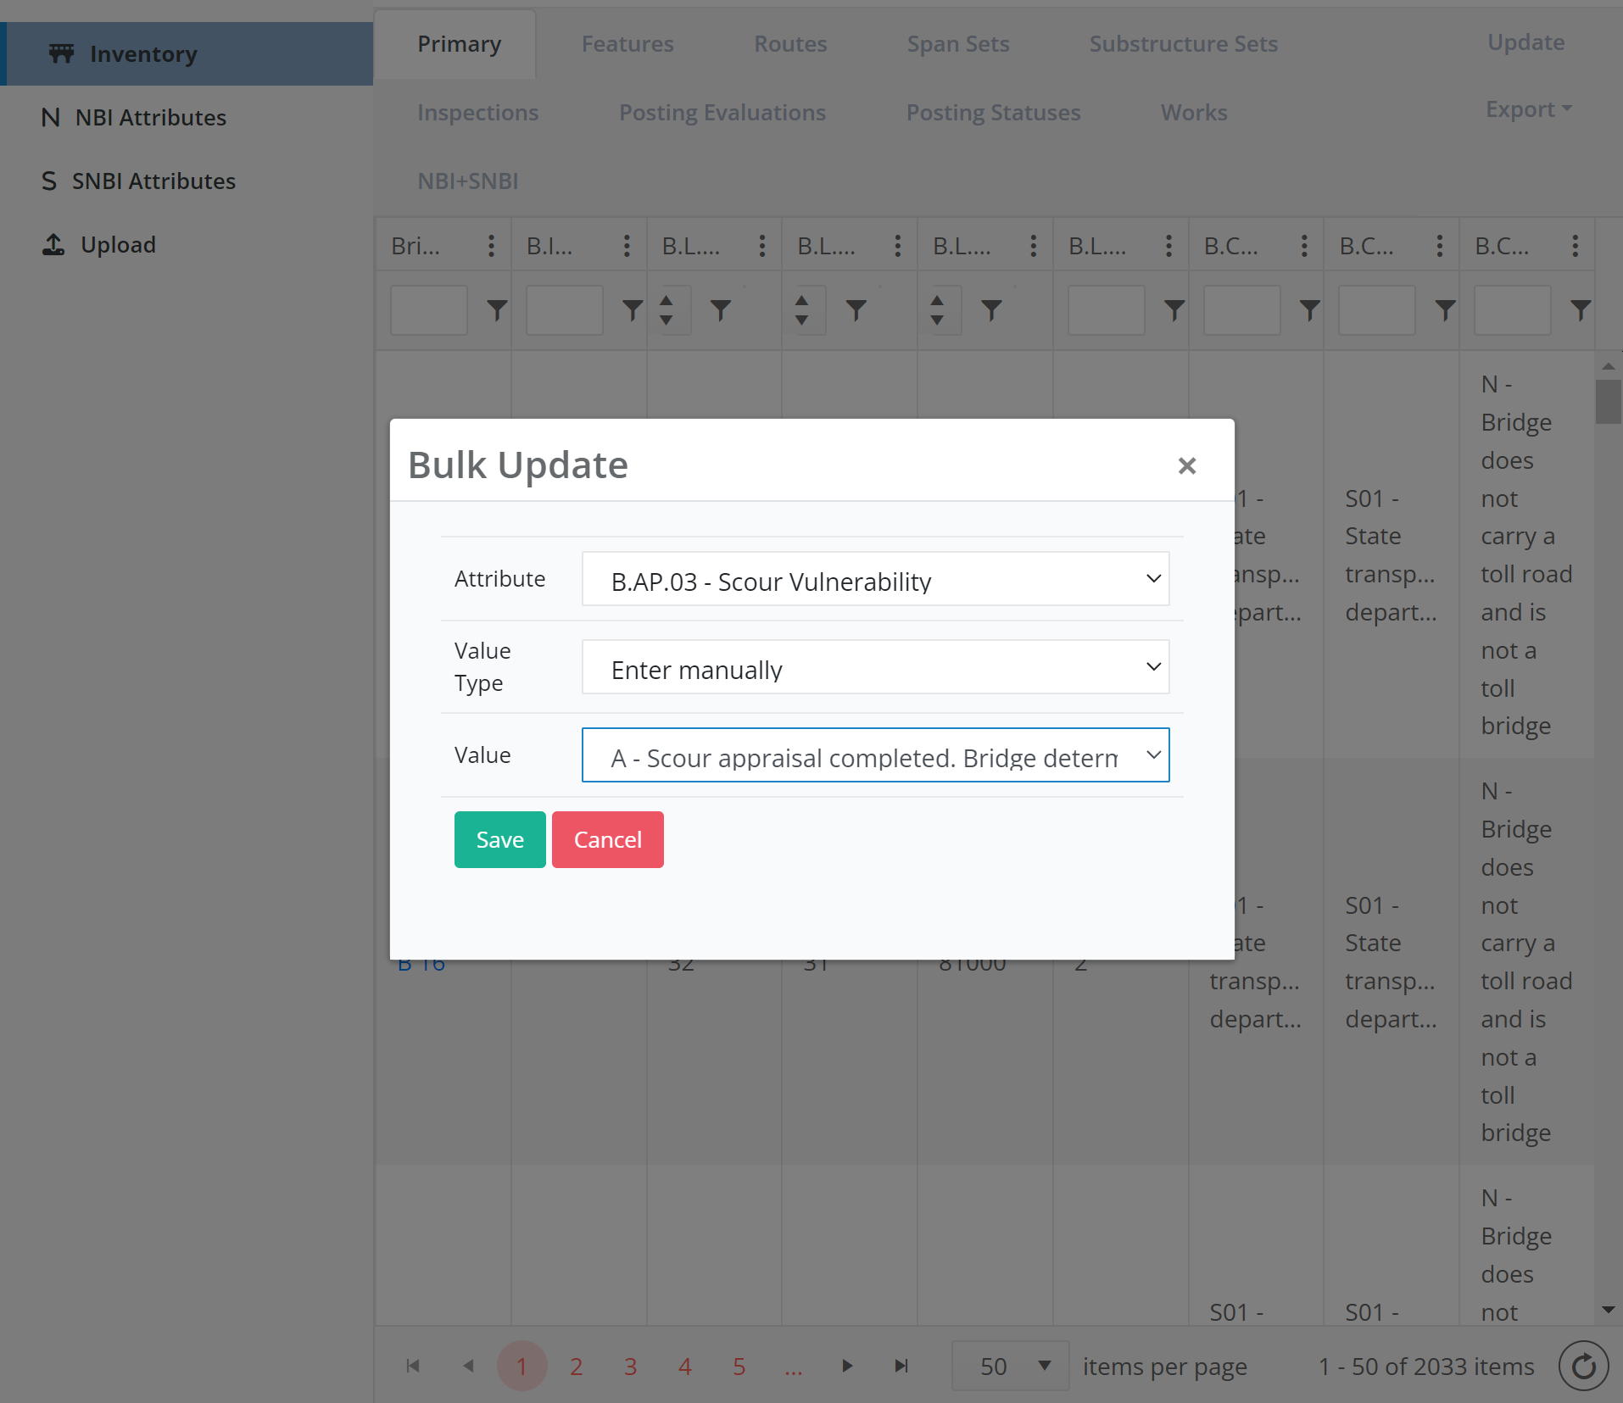
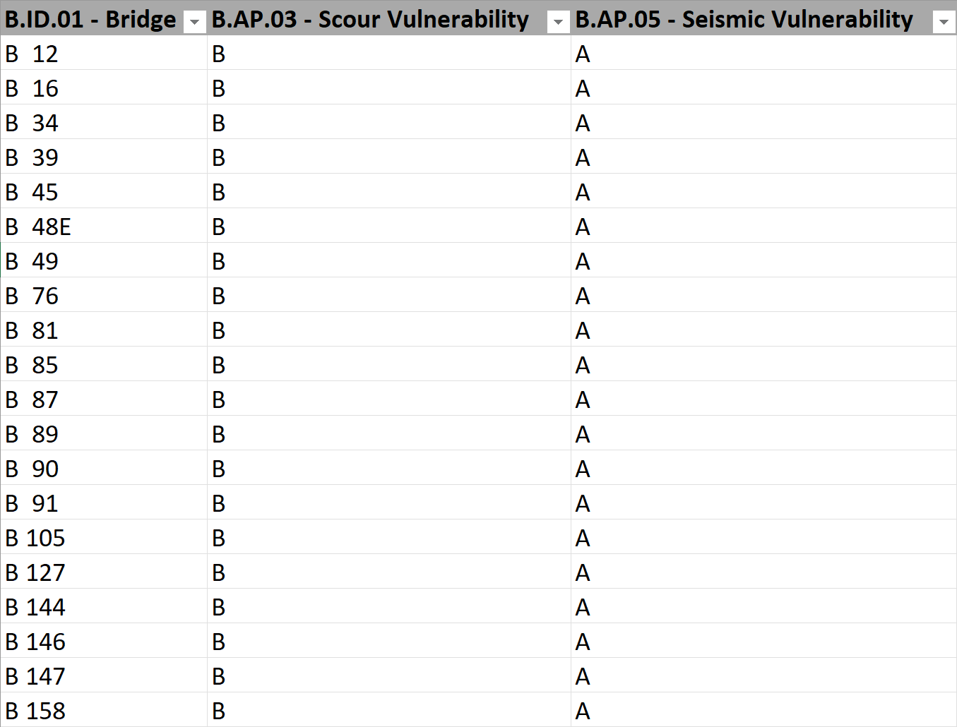
SNBI Data Collection
Add missing data (ie. no transition fields)
Overwrite transitioned data (ie. temp codes)
Add/remove many-to-one data (ie. features)
Bulk edit using Excel or UI
Filter a set of bridges
Bulk update a SNBI attribute; or
Bulk update any SNBI attributes with Excel

Slide 23
SNBI Data Collection
Add missing data (ie. no transition fields)
Overwrite transitioned data (ie. temp codes)
Add/remove many-to-one data (ie. features)
Bulk edit using the UI or Excel
All attributes have built-in validations and lookups

Slide 24
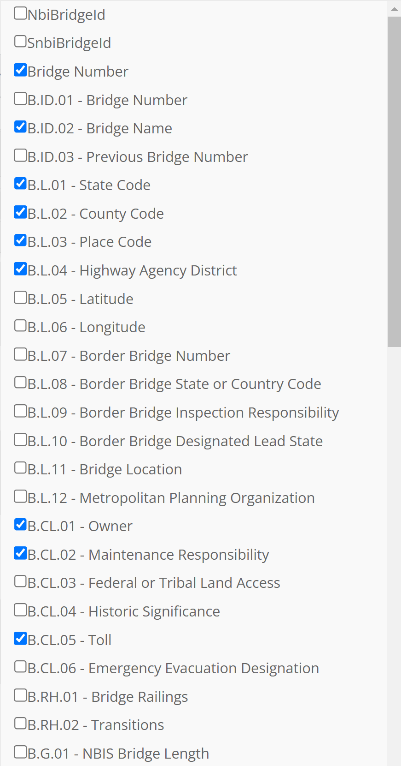
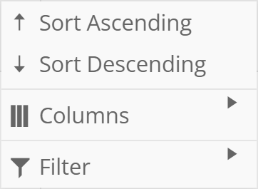
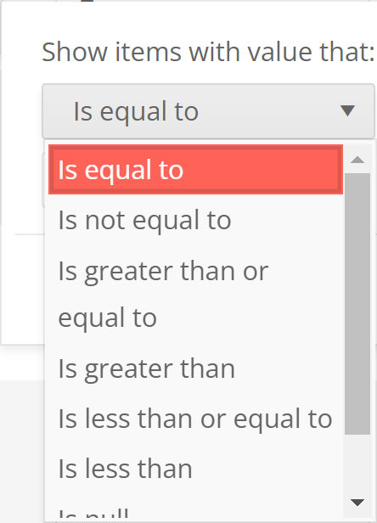
Data Management
Provide view of SNBI data in tabular format
Sort and filter based on any data sets
Hide/show any number of columns

Slide 25
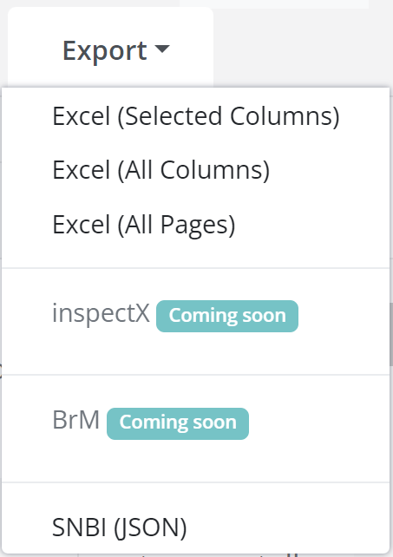
Data Management
Provide view of SNBI data in tabular format
Export data in various ways
Export current data set with selected columns
Export current data set with all columns
Export all data sets (including many-to-one)
Export in JSON format
Export data to inspectX (coming soon)
Can be automated on a schedule basis
Export data to BrM (coming soon)

Slide 26
SNBIX Demo

Slide 27
Let the software do the work for you
Import NBI Tape
Automated Transition
Import FHWA Transition
Review Data
Add/Edit Data
Export SNBI Data
No data processing is required from your end!

Slide 28
Summary

Slide 29
SNBIX Roadmap
Integrate with inspectX
Integrate with BrM
Implement review workflow
Group based access for bridges
Incorporate SNBI manual inside the tool
Implement an advanced filter and saved filters
Transition agency fields to SNBI

Slide 30
Benefits to inspectX clients
Use SNBIX to transition your NBI and agency data
Review and finalize your data
Push to inspectX production
Collect the remaining data using tablet in the field or from the office

Slide 31
Benefits to everyone else
No need to wait for your software vendor
Can start data collection and transition immediately
Easy to adopt and use by your staff and consultants
Less errors and more efficient compared to Excel/Access
Export SNBI data whenever your software is ready

Slide 32
Poll Question
Will your agency or company benefit from SNBIX ?
Yes, we need this now
Yes, we need it when we are ready to collect data
Maybe, we will need to think about it
No, we do not need it
Not sure
Notes:
500k to gain access in 2023
Otherwise in 2024

Slide 33
Q & A

Slide 34
Thank You
KENNY TONG
CUSTOMER SUCCESS MANAGER
ktong@bridge-intel.com

